Slide 1
Welcome

Slide 2
Testing

Slide 3
Testing
Make sure that features you’ve implemented work as intended

Slide 4
Benefit of Testing

Slide 5
Benefit of Testing
Rapid feedback on failures

Slide 6
Benefit of Testing
Rapid feedback on failures
Early failure detection

Slide 7
Benefit of Testing
Rapid feedback on failures
Early failure detection
Safer code refactoring

Slide 8
Benefit of Testing
Rapid feedback on failures
Early failure detection
Safer code refactoring
Stable development env.

Slide 9
Test Driven Development

Slide 10
TDD

Slide 11
Testing Pyramid
Notes:
Small tests are unit tests that validate your app's behavior one class at a time.
Medium tests are integration tests that validate either interactions between levels of the stack within a module, or interactions between related modules.
Large tests are end-to-end tests that validate user journeys spanning multiple modules of your app.

Slide 12
Testing Pyramid
Large tests
Medium tests
Small tests
Notes:
Small tests are unit tests that validate your app's behavior one class at a time.
Medium tests are integration tests that validate either interactions between levels of the stack within a module, or interactions between related modules.
Large tests are end-to-end tests that validate user journeys spanning multiple modules of your app.

Slide 13
Testing Pyramid
Large tests
10%
Medium tests
20%
Small tests
70%
Notes:
Small tests are unit tests that validate your app's behavior once class at a time. “Validate the functionality”.
Medium tests are integration tests that validate either interactions between levels of the stack within a module, or interactions between related modules.
Large tests are end-to-end tests that validate user journeys spanning multiple modules of your app.

Slide 14
How can I know the level?
Notes:
Small tests are unit tests that validate your app's behavior once class at a time. “Validate the functionality”.
Medium tests are integration tests that validate either interactions between levels of the stack within a module, or interactions between related modules.
Large tests are end-to-end tests that validate user journeys spanning multiple modules of your app.

Slide 15
Small
Notes:
Small tests are unit tests that validate your app's behavior once class at a time. “Validate the functionality”.
Medium tests are integration tests that validate either interactions between levels of the stack within a module, or interactions between related modules.
Large tests are end-to-end tests that validate user journeys spanning multiple modules of your app.

Slide 16
Small
Class at a time
Notes:
Small tests are unit tests that validate your app's behavior once class at a time. “Validate the functionality”.
Medium tests are integration tests that validate either interactions between levels of the stack within a module, or interactions between related modules.
Large tests are end-to-end tests that validate user journeys spanning multiple modules of your app.

Slide 17
Small
Class at a time
Validate the functionality
Notes:
Small tests are unit tests that validate your app's behavior once class at a time. “Validate the functionality”.
Medium tests are integration tests that validate either interactions between levels of the stack within a module, or interactions between related modules.
Large tests are end-to-end tests that validate user journeys spanning multiple modules of your app.

Slide 18
Small
Medium
Class at a time
Validate the functionality
Notes:
Small tests are unit tests that validate your app's behavior once class at a time. “Validate the functionality”.
Medium tests are integration tests that validate either interactions between levels of the stack within a module, or interactions between related modules.
Large tests are end-to-end tests that validate user journeys spanning multiple modules of your app.

Slide 19
Small
Medium
Validating XML layout
Class at a time
Validate the functionality
Notes:
Small tests are unit tests that validate your app's behavior once class at a time. “Validate the functionality”.
Medium tests are integration tests that validate either interactions between levels of the stack within a module, or interactions between related modules.
Large tests are end-to-end tests that validate user journeys spanning multiple modules of your app.

Slide 20
Small
Medium
Validating XML layout
Testing Fragment Object
Class at a time
Validate the functionality
Notes:
Small tests are unit tests that validate your app's behavior once class at a time. “Validate the functionality”.
Medium tests are integration tests that validate either interactions between levels of the stack within a module, or interactions between related modules.
Large tests are end-to-end tests that validate user journeys spanning multiple modules of your app.

Slide 21
Small
Medium
Validating XML layout
Testing Fragment Object
Testing interaction between data sources and DAOs
Class at a time
Validate the functionality
Notes:
Small tests are unit tests that validate your app's behavior once class at a time. “Validate the functionality”.
Medium tests are integration tests that validate either interactions between levels of the stack within a module, or interactions between related modules.
Large tests are end-to-end tests that validate user journeys spanning multiple modules of your app.

Slide 22
Small
Medium
Large
Validating XML layout
Testing Fragment Object
Testing interaction between data sources and DAOs
Class at a time
Validate the functionality
Notes:
Small tests are unit tests that validate your app's behavior once class at a time. “Validate the functionality”.
Medium tests are integration tests that validate either interactions between levels of the stack within a module, or interactions between related modules.
Large tests are end-to-end tests that validate user journeys spanning multiple modules of your app.

Slide 23
Small
Medium
Large
Validating XML layout
Testing Fragment Object
Testing interaction between data sources and DAOs
Class at a time
Validate the functionality
End-to-end workflows
Notes:
Small tests are unit tests that validate your app's behavior once class at a time. “Validate the functionality”.
Medium tests are integration tests that validate either interactions between levels of the stack within a module, or interactions between related modules.
Large tests are end-to-end tests that validate user journeys spanning multiple modules of your app.

Slide 24
Small test
Notes:
Small tests are unit tests that validate your app's behavior once class at a time. “Validate the functionality”.
Medium tests are integration tests that validate either interactions between levels of the stack within a module, or interactions between related modules.
Large tests are end-to-end tests that validate user journeys spanning multiple modules of your app.

Slide 25
Small Test = Unit test

Slide 26
Unit test
If your tests rely on resources, enable the
includeAndroidResources option in app gradle
Notes:
Small tests are unit tests that validate your app's behavior once class at a time. “Validate the functionality”.
Medium tests are integration tests that validate either interactions between levels of the stack within a module, or interactions between related modules.
Large tests are end-to-end tests that validate user journeys spanning multiple modules of your app.

Slide 27
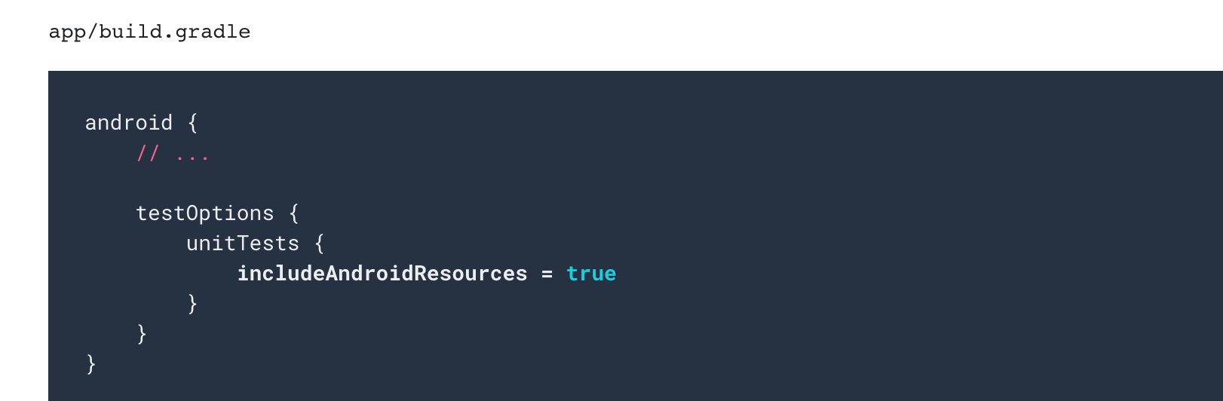
Unit test
Notes:
Small tests are unit tests that validate your app's behavior once class at a time. “Validate the functionality”.
Medium tests are integration tests that validate either interactions between levels of the stack within a module, or interactions between related modules.
Large tests are end-to-end tests that validate user journeys spanning multiple modules of your app.

Slide 28
Unit test
Notes:
Small tests are unit tests that validate your app's behavior once class at a time. “Validate the functionality”.
Medium tests are integration tests that validate either interactions between levels of the stack within a module, or interactions between related modules.
Large tests are end-to-end tests that validate user journeys spanning multiple modules of your app.

Slide 29
Medium test
Notes:
Small tests are unit tests that validate your app's behavior once class at a time. “Validate the functionality”.
Medium tests are integration tests that validate either interactions between levels of the stack within a module, or interactions between related modules.
Large tests are end-to-end tests that validate user journeys spanning multiple modules of your app.

Slide 30
Medium Test = Integration Test

Slide 31
Integration Test

Slide 32
Integration Test

Slide 33
Integration Test
1
2
3
4
5
6

Slide 34
Large Test

Slide 35
Large Test = UI Test

Slide 36
UI Test

Slide 37
UI Test
Single app

Slide 38
UI Test
Single app
Multiple app

Slide 39
Testing Frameworks

Slide 40
UI Test
Single app
Multiple app
Espresso

Slide 41
UI Test
Single app
Multiple app
Espresso
UI Automator

Slide 42
Pre-requisites

Slide 43
Pre-requisites
Add dependencies
Turn animations off

Slide 44
Testing Steps

Slide 45
Testing Steps
Find the view

Slide 46
Testing Steps
Find the view
Perform action

Slide 47
Testing Steps
Find the view
Perform action
Check

Slide 48
Testing Steps
Find the view
Perform action
Check
Find a button

Slide 49
Testing Steps
Find the view
Perform action
Check
Find a button
Click the button

Slide 50
Testing Steps
Find the view
Perform action
Check
Find a button
Click the button
Behave as expected?

Slide 51
Espresso UI Testing

Slide 52
Views

Slide 53
Views
AdapterViews

Slide 54
Views
AdapterViews
Intents

Slide 55
Views
AdapterViews
Intents
Idling resources

Slide 56
Views

Slide 57
Views
Find the view
Notes:
A class that helps us to specify the view that we are interested in in the current view hierarchy
Hamcrest matcher lib = help us to do what we want using a human readable language such as withId()

Slide 58
Views
Find the view
onView()
Notes:
A class that helps us to specify the view that we are interested in in the current view hierarchy
Hamcrest matcher lib = help us to do what we want using a human readable language such as withId()

Slide 59
Views
Find the view
onView(withId())
Notes:
A class that helps us to specify the view that we are interested in in the current view hierarchy
Hamcrest matcher lib = help us to do what we want using a human readable language such as withId()

Slide 60
Views
Find the view
onView(withId(R.id.my_button_id))
Notes:
A class that helps us to specify the view that we are interested in in the current view hierarchy
Hamcrest matcher lib = help us to do what we want using a human readable language such as withId()

Slide 61
Views
Find the view
onView(withId(R.id.my_button_id))
Perform action
Notes:
A class that helps us to specify the view that we are interested in in the current view hierarchy
Hamcrest matcher lib = help us to do what we want using a human readable language such as withId()

Slide 62
Views
Find the view
onView(withId(R.id.my_button_id))
Perform action
perform()
Notes:
A class that helps us to specify the view that we are interested in in the current view hierarchy
Hamcrest matcher lib = help us to do what we want using a human readable language such as withId()

Slide 63
Views
Find the view
onView(withId(R.id.my_button_id))
Perform action
perform(click())
Notes:
A class that helps us to specify the view that we are interested in in the current view hierarchy
Hamcrest matcher lib = help us to do what we want using a human readable language such as withId()

Slide 64
Views
Find the view
onView(withId(R.id.my_button_id))
Perform action
perform(click())
Notes:
A class that helps us to specify the view that we are interested in in the current view hierarchy
Hamcrest matcher lib = help us to do what we want using a human readable language such as withId()

Slide 65
Views
Check
onView(withId(R.id.my_textview))
Notes:
A class that helps us to specify the view that we are interested in in the current view hierarchy
Hamcrest matcher lib = help us to do what we want using a human readable language such as withId()

Slide 66
Views
Check
onView(withId(R.id.my_textview))
.check()
Notes:
A class that helps us to specify the view that we are interested in in the current view hierarchy
Hamcrest matcher lib = help us to do what we want using a human readable language such as withId()

Slide 67
Views
Check
onView(withId(R.id.my_textview))
.check(isDisplayed())
Notes:
A class that helps us to specify the view that we are interested in in the current view hierarchy
Hamcrest matcher lib = help us to do what we want using a human readable language such as withId()

Slide 68
Views
Understand more
Notes:
A class that helps us to specify the view that we are interested in in the current view hierarchy
Hamcrest matcher lib = help us to do what we want using a human readable language such as withId()

Slide 69
Views
onView( ViewMatcher )
Notes:
A class that helps us to specify the view that we are interested in in the current view hierarchy
Hamcrest matcher lib = help us to do what we want using a human readable language such as withId()

Slide 70
Views
onView( ViewMatcher )
perform( ViewAction )
Notes:
A class that helps us to specify the view that we are interested in in the current view hierarchy
Hamcrest matcher lib = help us to do what we want using a human readable language such as withId()

Slide 71
Views
onView( ViewMatcher )
perform( ViewAction )
check( ViewAssertion )
Notes:
A class that helps us to specify the view that we are interested in in the current view hierarchy
Hamcrest matcher lib = help us to do what we want using a human readable language such as withId()

Slide 72
Espresso Cheat Sheet

Slide 74
AdapterViews

Slide 75
AdapterViews
Notes:
Since AdapterViews such as ListView and GridView load data dynamically from an Adapter, only a subset of the contents may be loaded in the current view hierarchy at a time
To handle this we need to use onData() which loads the adapter item we are interested in onto the screen before operating on it.

Slide 76
AdapterViews vs Views
Notes:
DataOptions example of at position, onChildView, inAdapterView
And we will see examples together later.

Slide 77
AdapterViews vs Views

Slide 78
Intents

Slide 79
Stub
Verification

Slide 80
Stub
Verification
Intending()
Intended()

Slide 83
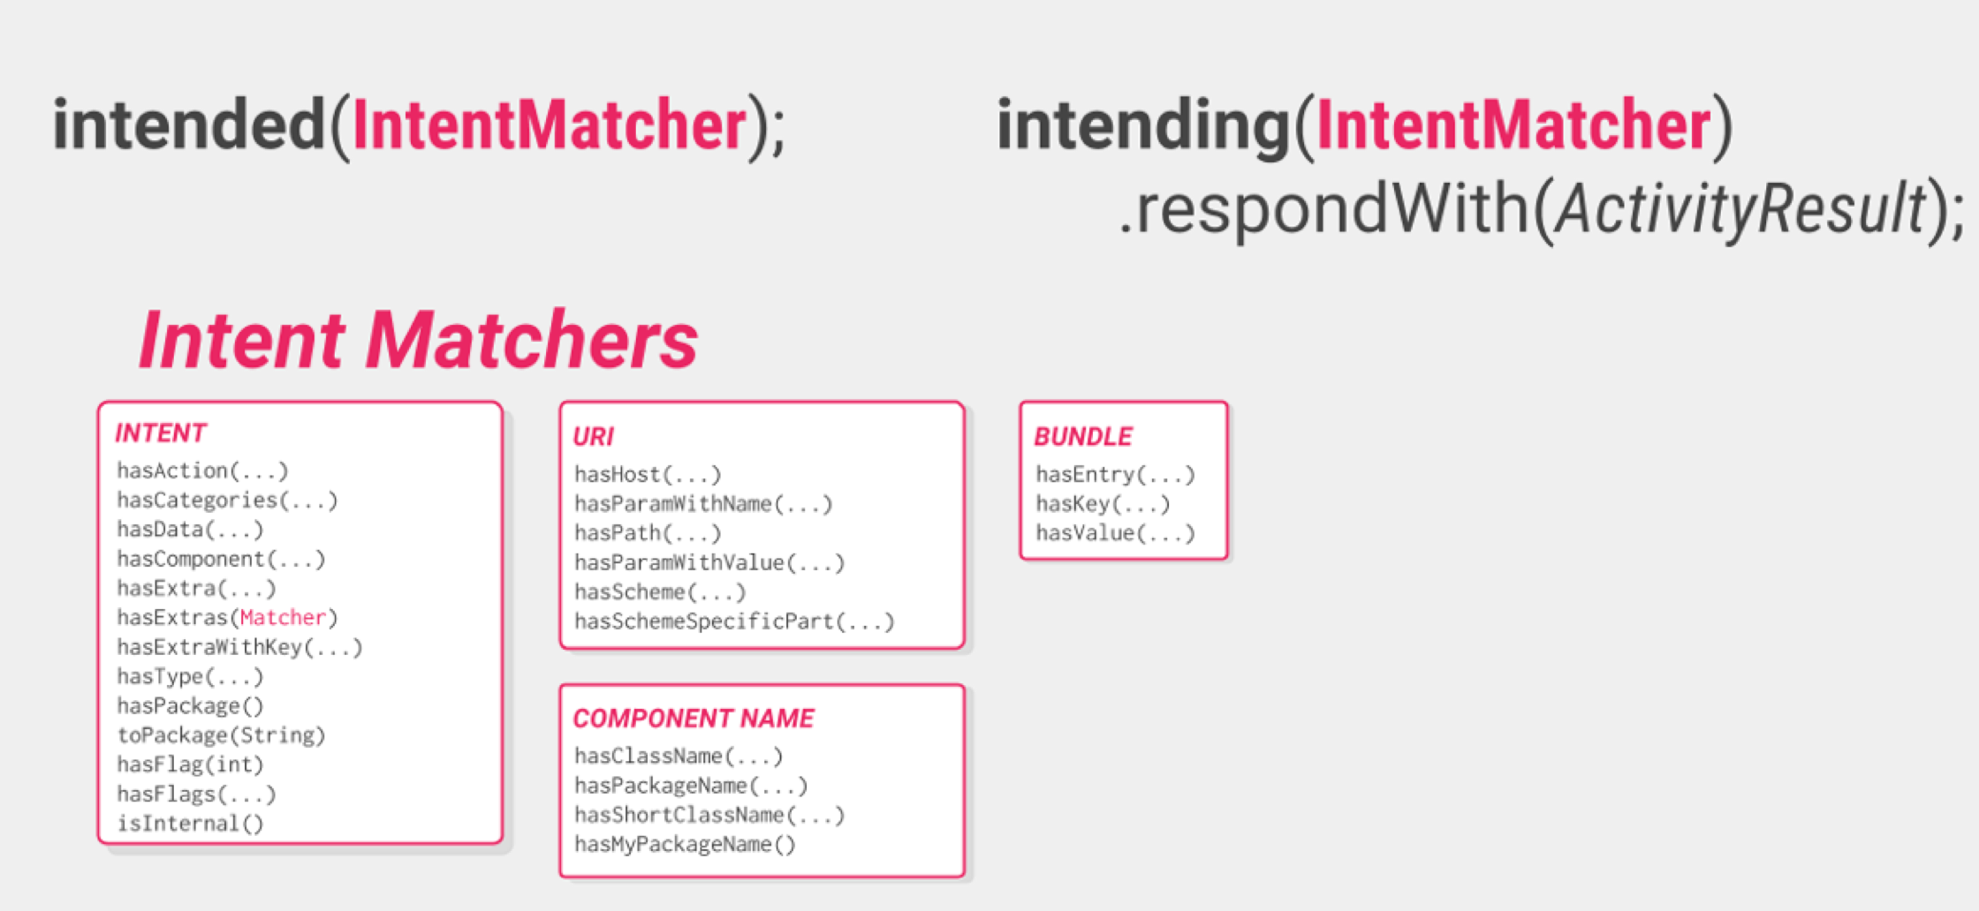

Slide 84
@Before
@After

Slide 85
@Before
@After
Intents.init()
Intents.release()

Slide 86
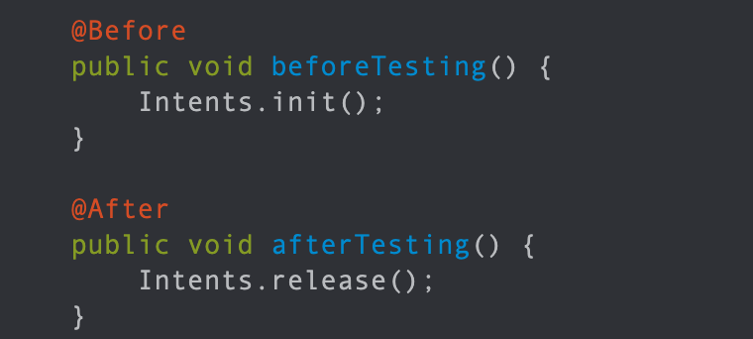

Slide 87
Idling resources

Slide 88
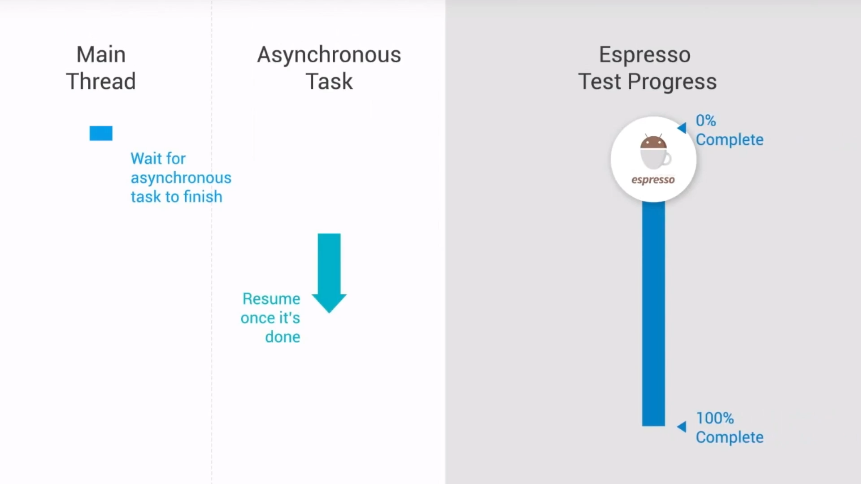

Slide 89
@Before
@Rule
Notes:
@Before
@Rule = if there is something will be used for so many test cases, it’d better to be annotated as Rule.

Slide 90
Recycler View Helper Methods

Slide 91
scrollTo()
Notes:
scrollTo() - Scrolls to the matched View, if it exists.
scrollToHolder() - Scrolls to the matched View Holder, if it exists.
scrollToPosition() - Scrolls to a specific position.
actionOnHolderItem() - Performs a View Action on a matched View Holder.
actionOnItem() - Performs a View Action on a matched View.
actionOnItemAtPosition() - Performs a ViewAction on a view at a specific position.

Slide 92
scrollTo()
scrollToHolder()
Notes:
scrollTo() - Scrolls to the matched View, if it exists.
scrollToHolder() - Scrolls to the matched View Holder, if it exists.
scrollToPosition() - Scrolls to a specific position.
actionOnHolderItem() - Performs a View Action on a matched View Holder.
actionOnItem() - Performs a View Action on a matched View.
c- Performs a ViewAction on a view at a specific position.

Slide 93
scrollTo()
scrollToHolder()
scrollToPosition()
Notes:
scrollTo() - Scrolls to the matched View, if it exists.
scrollToHolder() - Scrolls to the matched View Holder, if it exists.
scrollToPosition() - Scrolls to a specific position.
actionOnHolderItem() - Performs a View Action on a matched View Holder.
actionOnItem() - Performs a View Action on a matched View.
c- Performs a ViewAction on a view at a specific position.

Slide 94
scrollTo()
scrollToHolder()
scrolToPosition()
actionOnHolderItem()
Notes:
scrollTo() - Scrolls to the matched View, if it exists.
scrollToHolder() - Scrolls to the matched View Holder, if it exists.
scrollToPosition() - Scrolls to a specific position.
actionOnHolderItem() - Performs a View Action on a matched View Holder.
actionOnItem() - Performs a View Action on a matched View.
c- Performs a ViewAction on a view at a specific position.

Slide 95
scrollTo()
scrollToHolder()
scrolToPosition()
actionOnHolderItem()
actionOnItem()
Notes:
scrollTo() - Scrolls to the matched View, if it exists.
scrollToHolder() - Scrolls to the matched View Holder, if it exists.
scrollToPosition() - Scrolls to a specific position.
actionOnHolderItem() - Performs a View Action on a matched View Holder.
actionOnItem() - Performs a View Action on a matched View.
actionOnItemAtPosition() - Performs a ViewAction on a view at a specific position.

Slide 96
scrollTo()
scrollToHolder()
scrolToPosition()
actionOnHolderItem()
actionOnItem()
actionOnItemAtPosition()
Notes:
scrollTo() - Scrolls to the matched View, if it exists.
scrollToHolder() - Scrolls to the matched View Holder, if it exists.
scrollToPosition() - Scrolls to a specific position.
actionOnHolderItem() - Performs a View Action on a matched View Holder.
actionOnItem() - Performs a View Action on a matched View.
actionOnItemAtPosition() - Performs a ViewAction on a view at a specific position.

Slide 97
scrollTo()
scrollToHolder()
scrolToPosition()
actionOnHolderItem()
actionOnItem()
actionOnItemAtPosition()
Recycler View Helper Methods
Notes:
scrollTo() - Scrolls to the matched View, if it exists.
scrollToHolder() - Scrolls to the matched View Holder, if it exists.
scrollToPosition() - Scrolls to a specific position.
actionOnHolderItem() - Performs a View Action on a matched View Holder.
actionOnItem() - Performs a View Action on a matched View.
actionOnItemAtPosition() - Performs a ViewAction on a view at a specific position.

Slide 98
Complicated test scenario

Slide 99
./gradlew lint
Notes:
Provide you with a full details of your project and code

Slide 100
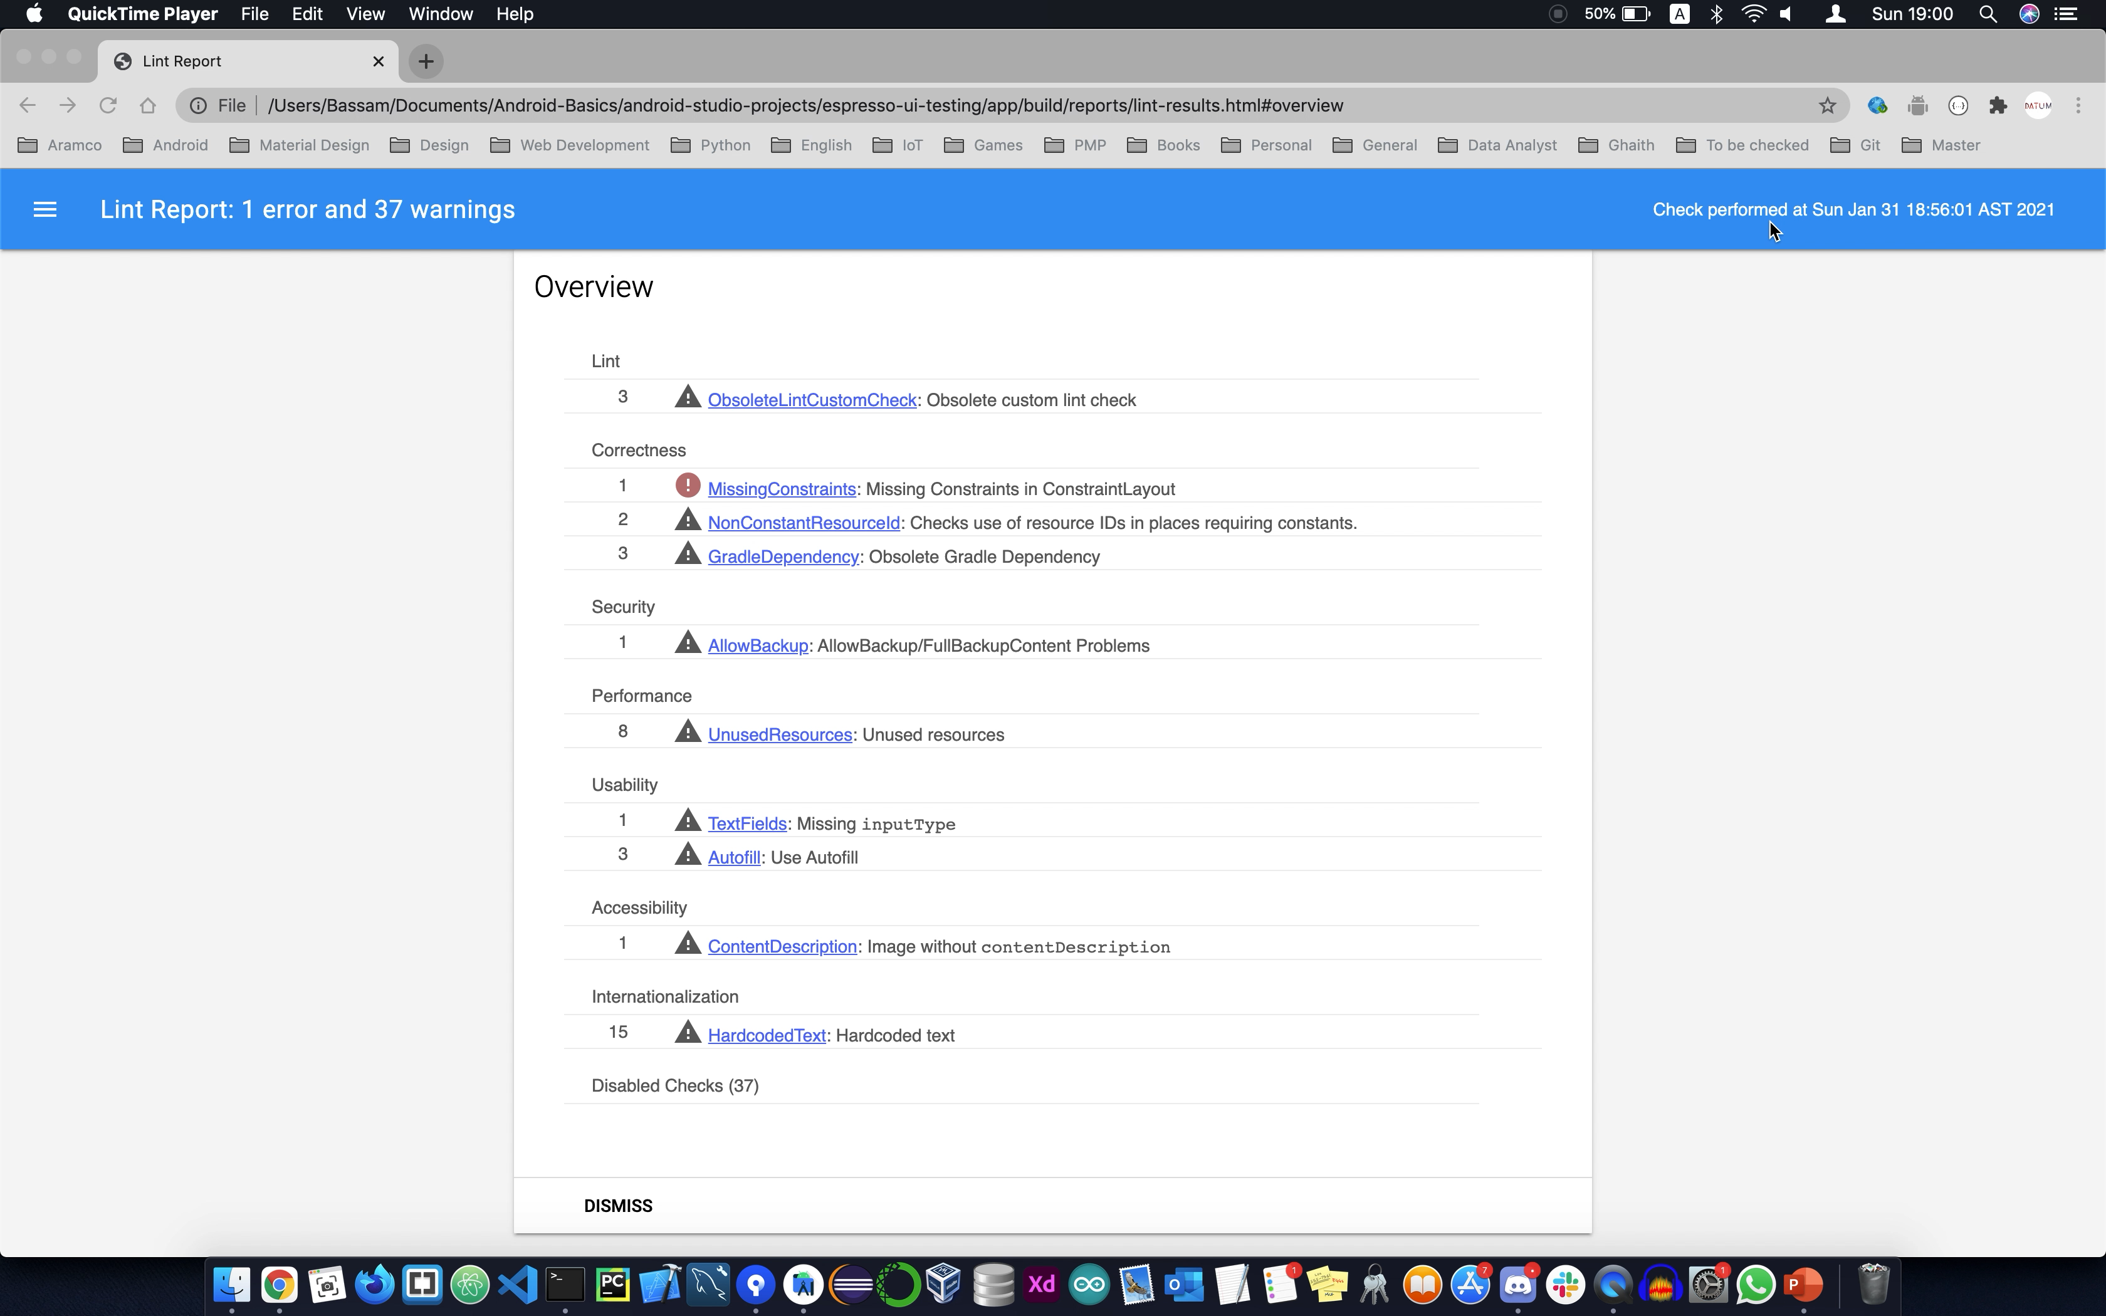

Slide 101
./gradlew connectedCheck
Notes:
Will do a full test for all your test scenarios and provide you with a detailed report.

Slide 102
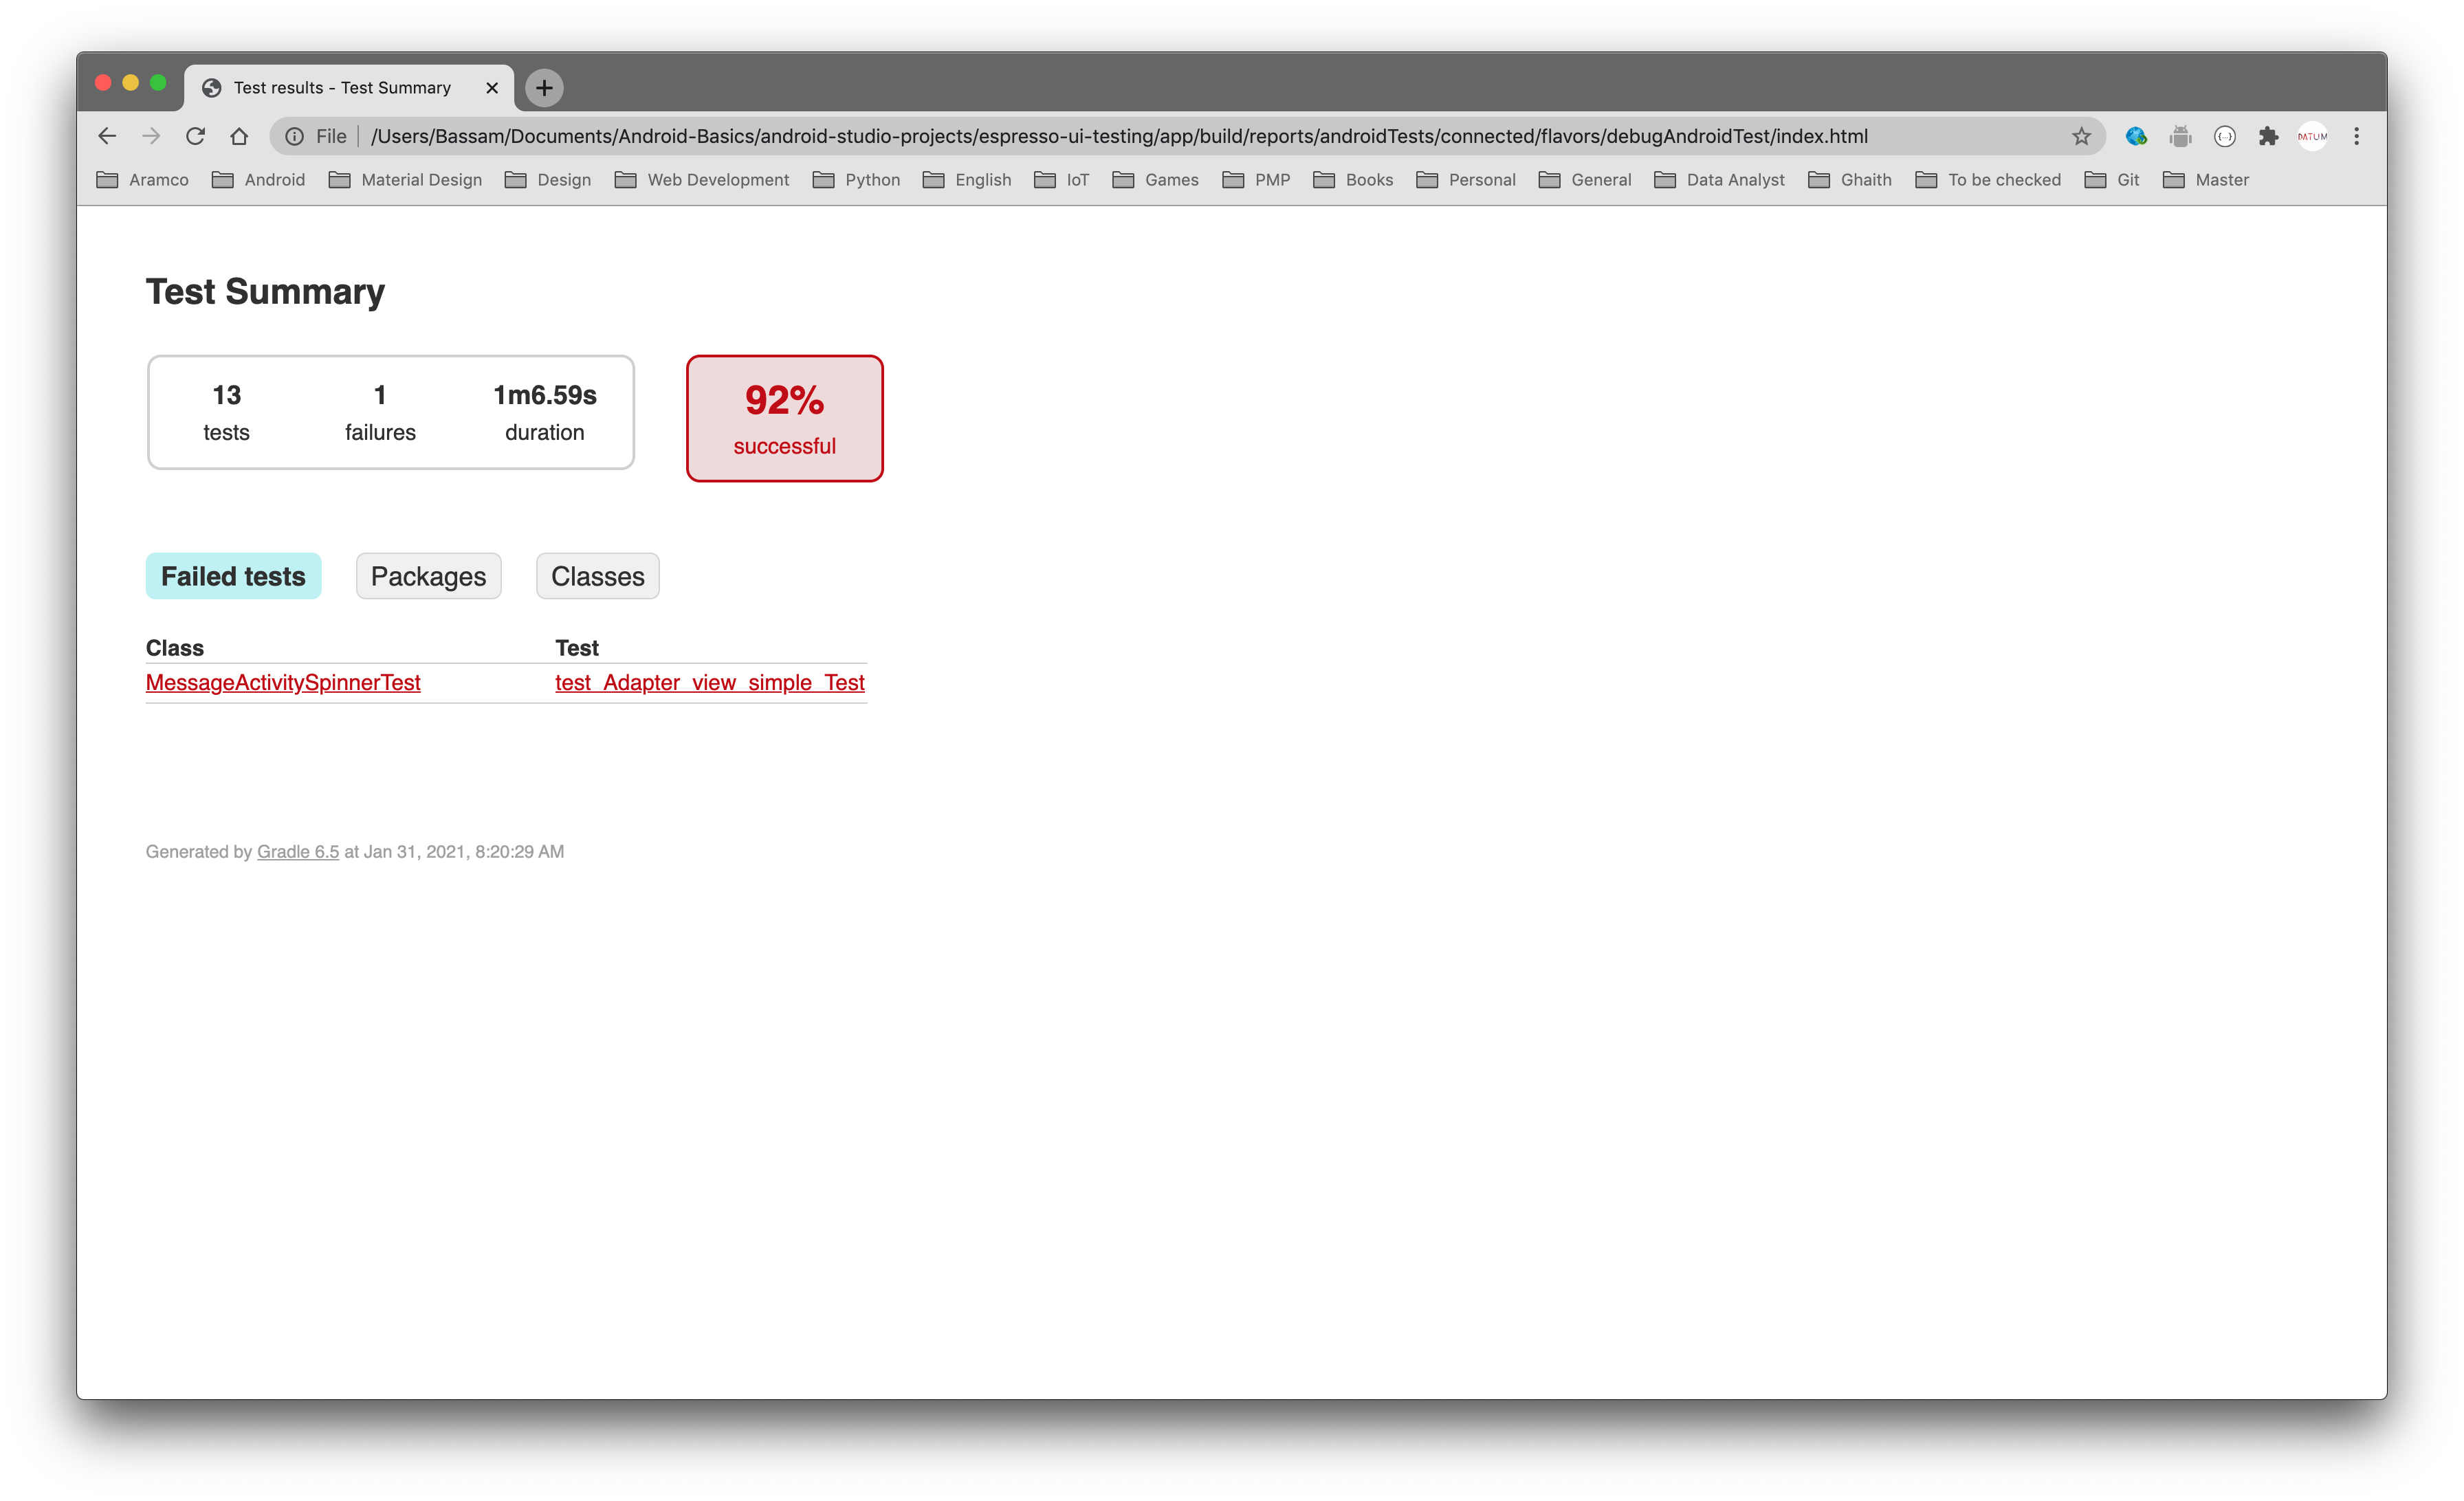
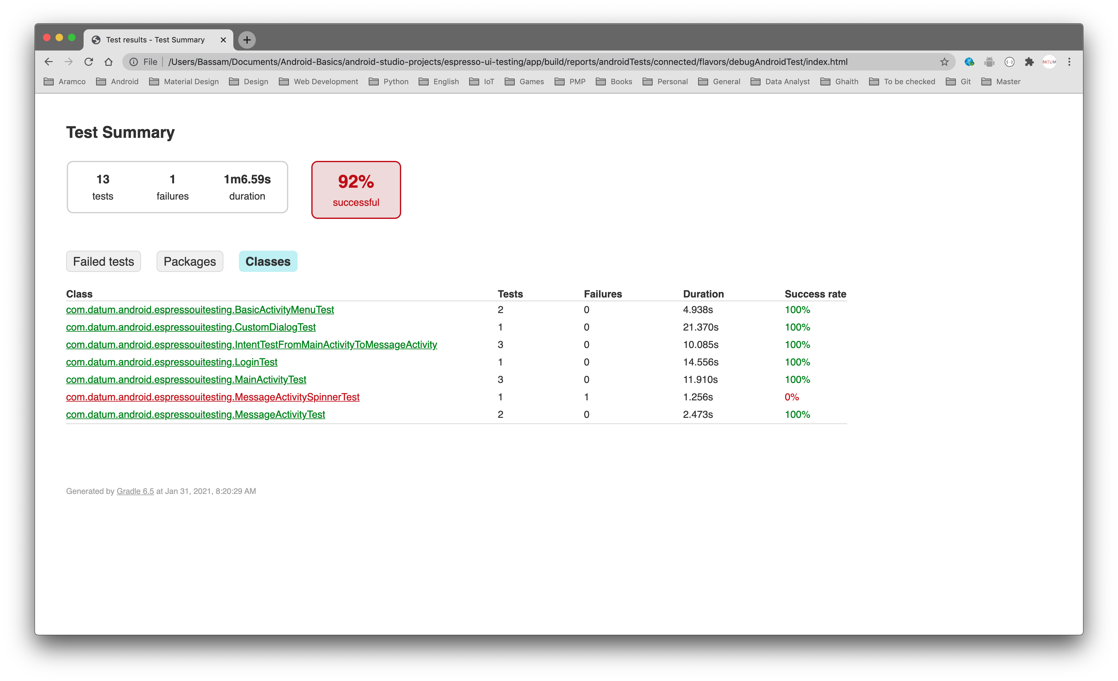
Notes:
Will do a full test for all your test scenarios and provide you with a detailed report.

Slide 103
Firebase lab testing

Slide 104
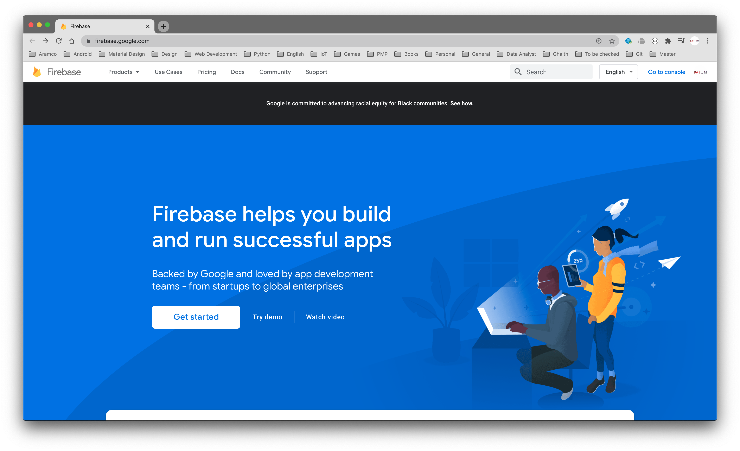

Slide 105
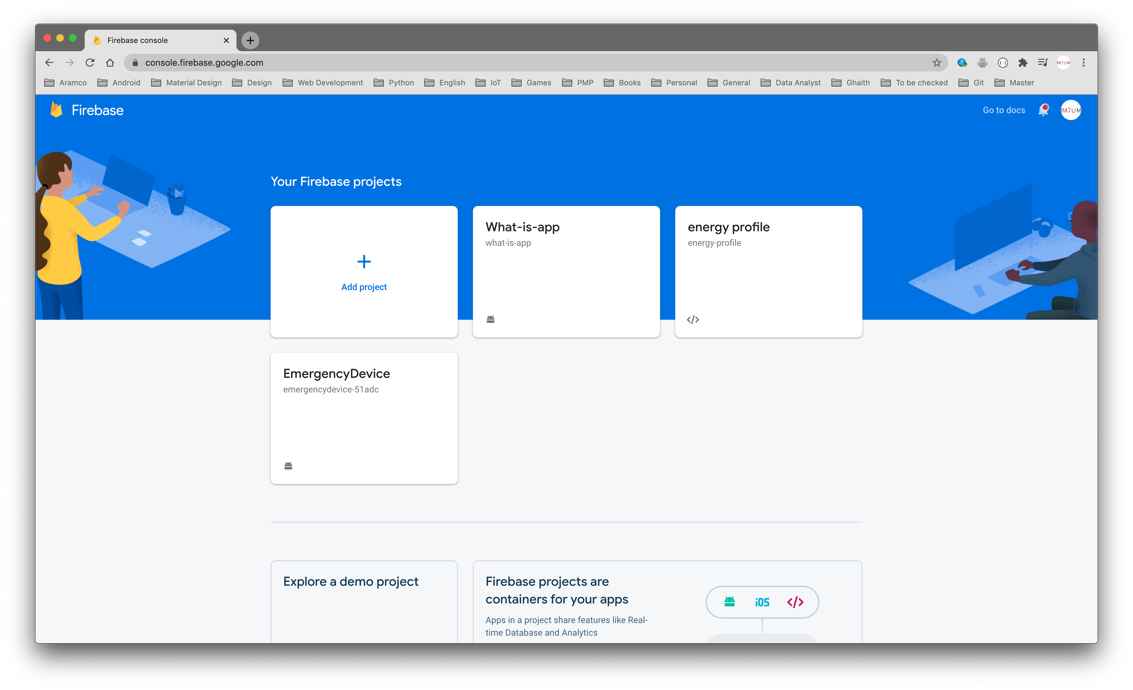

Slide 106
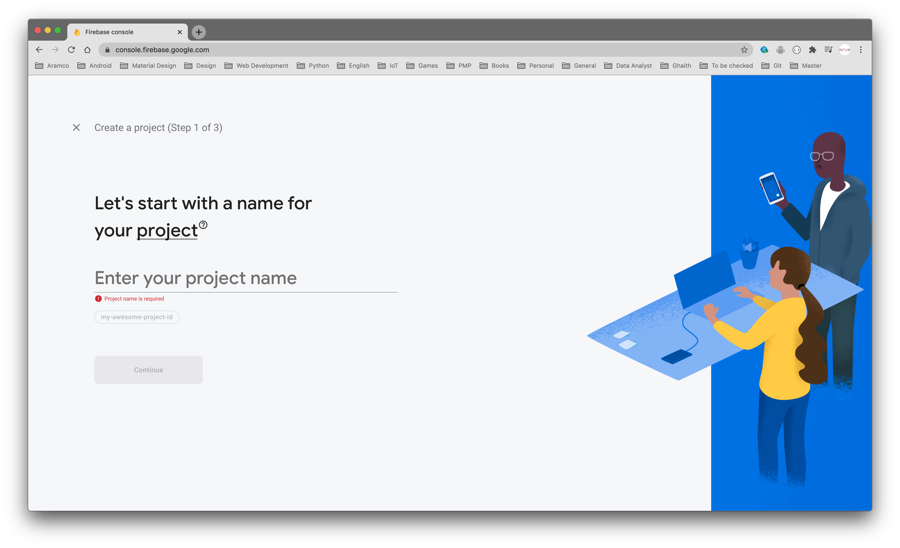

Slide 107
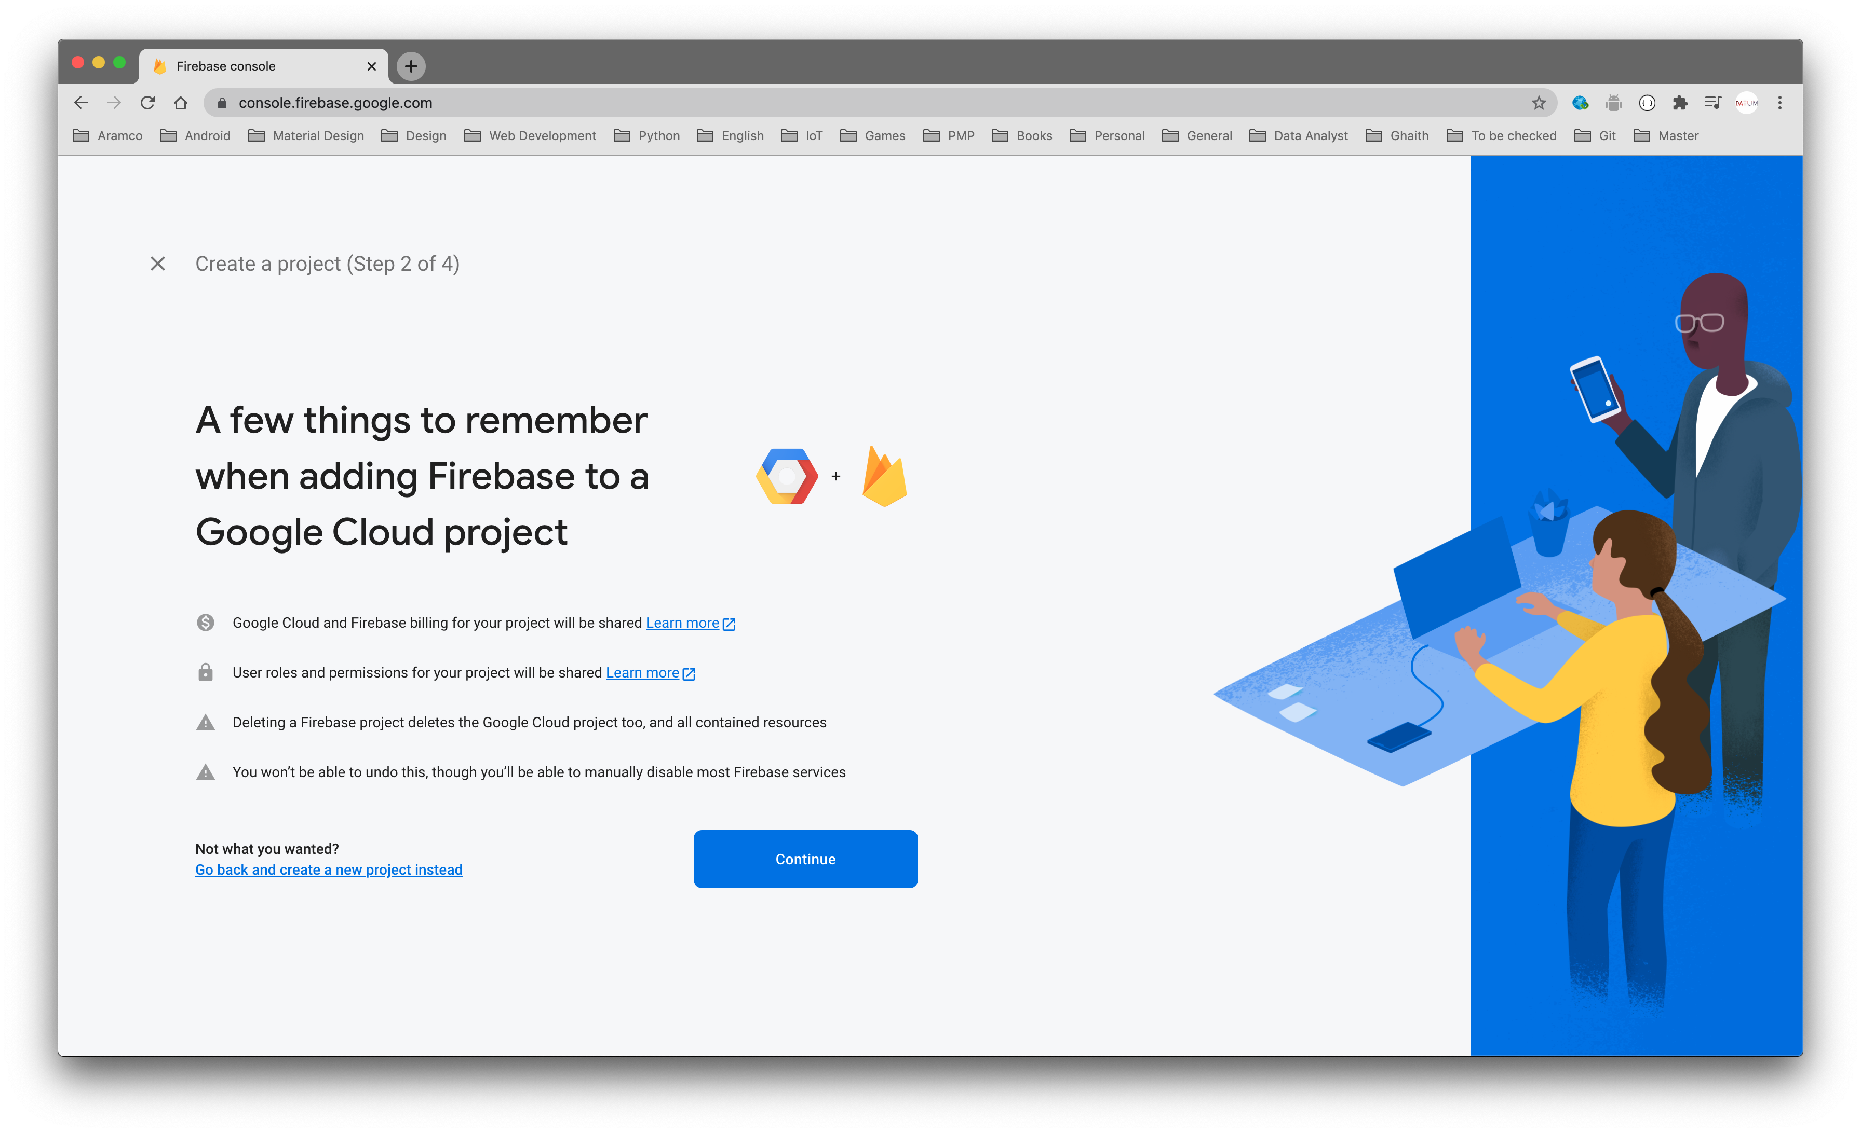

Slide 108
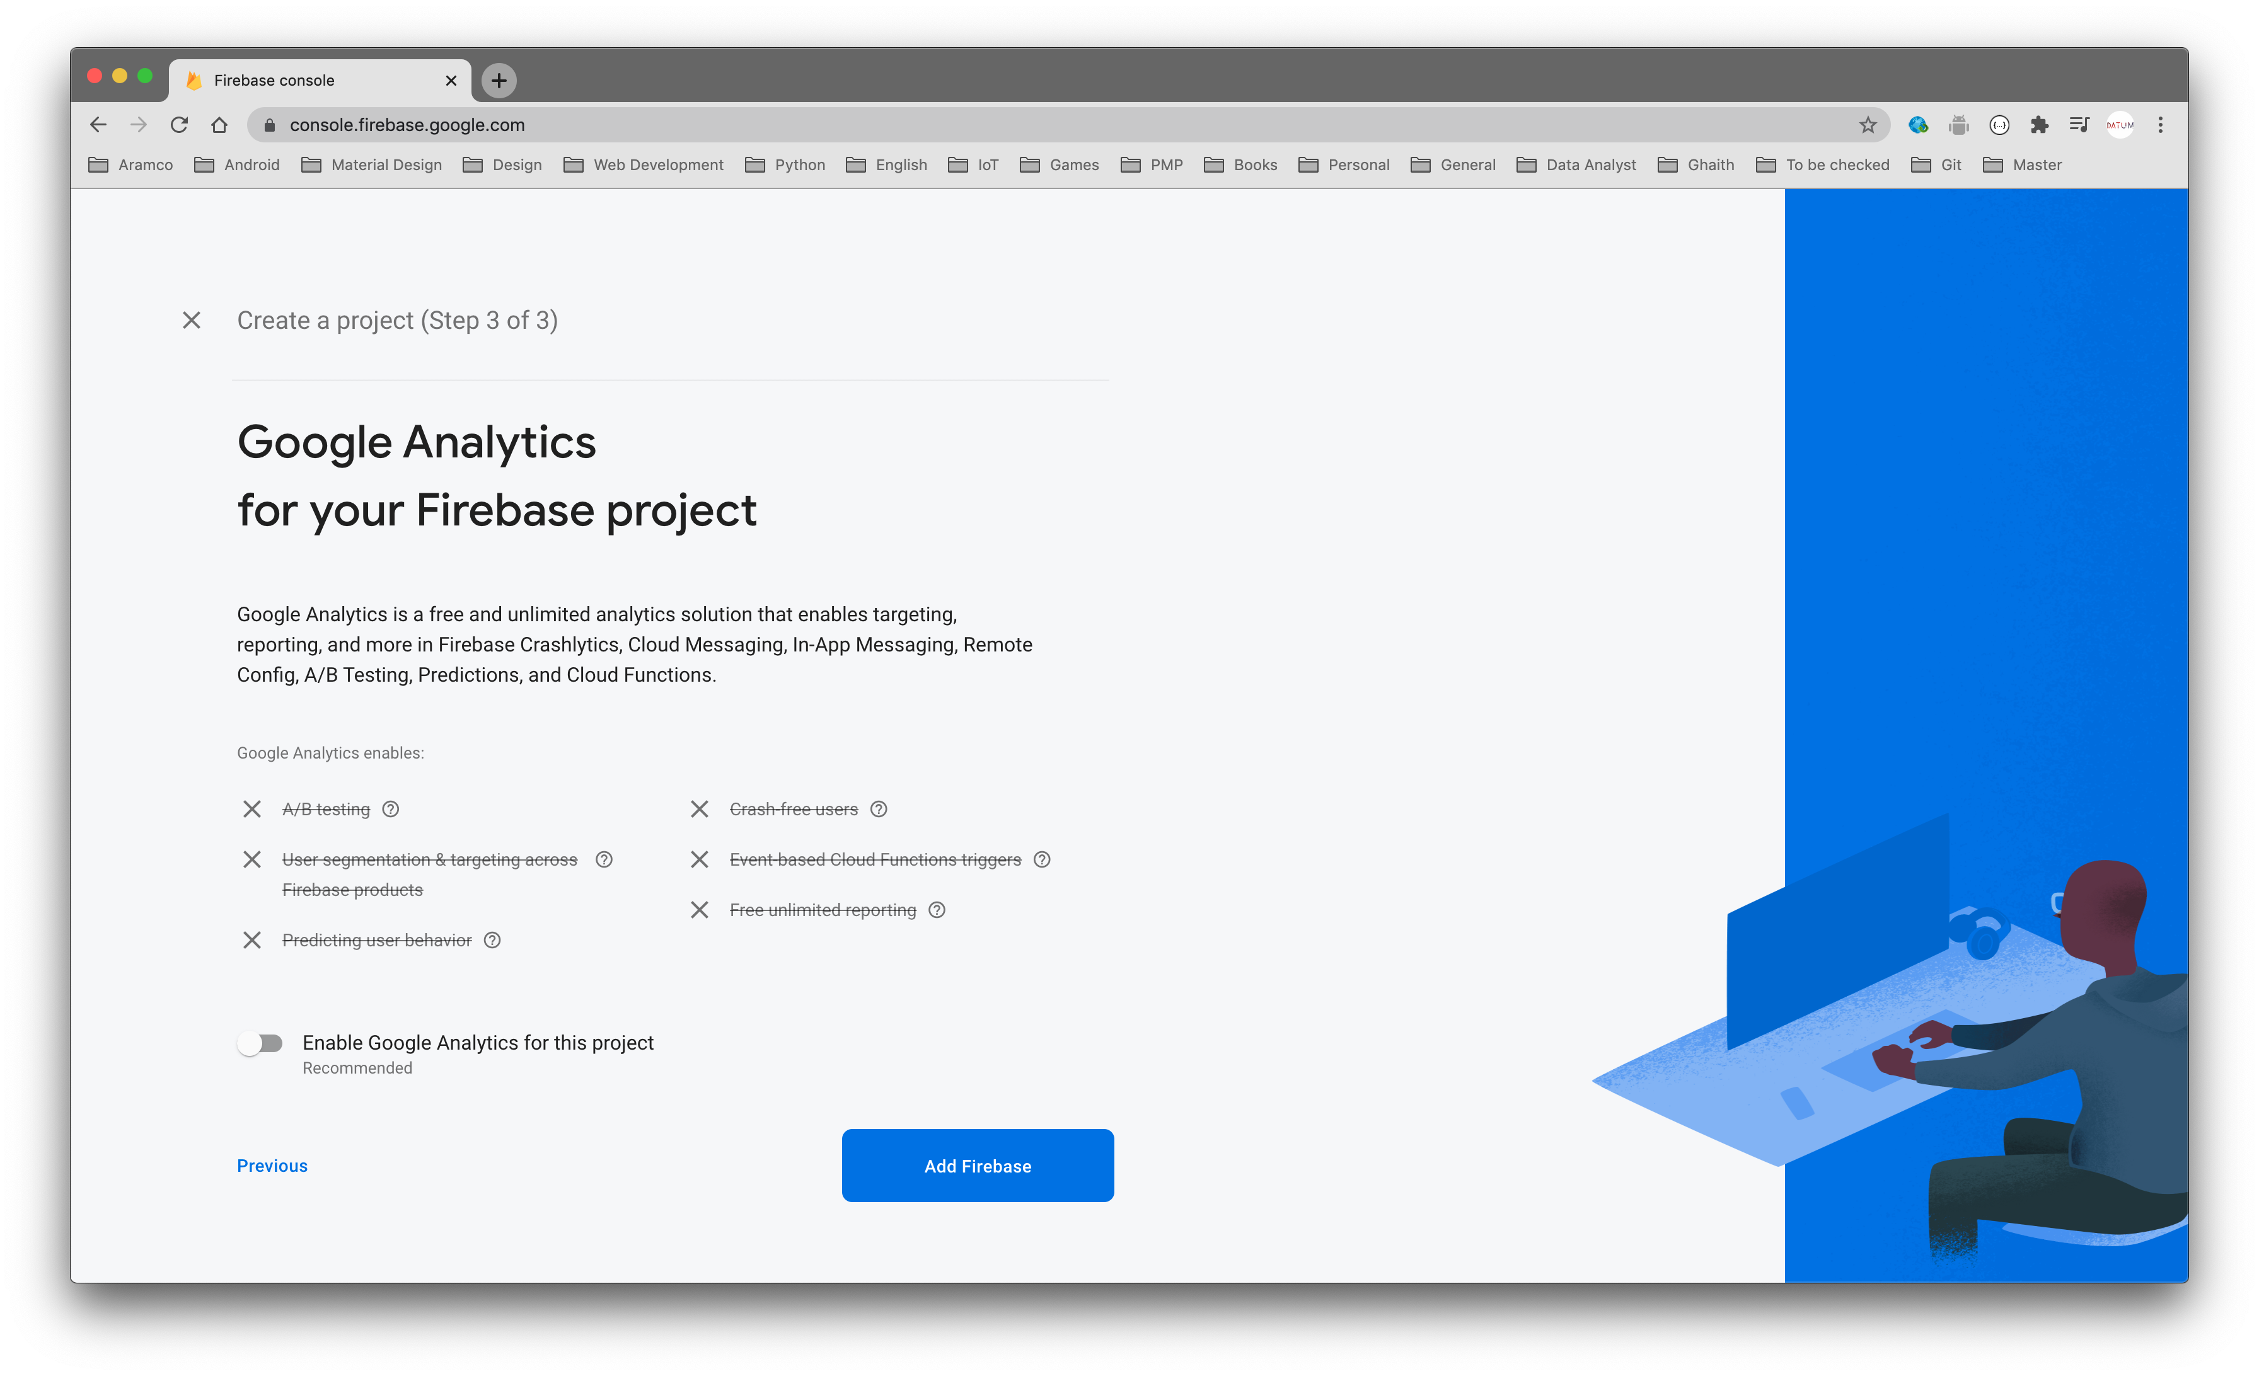

Slide 109
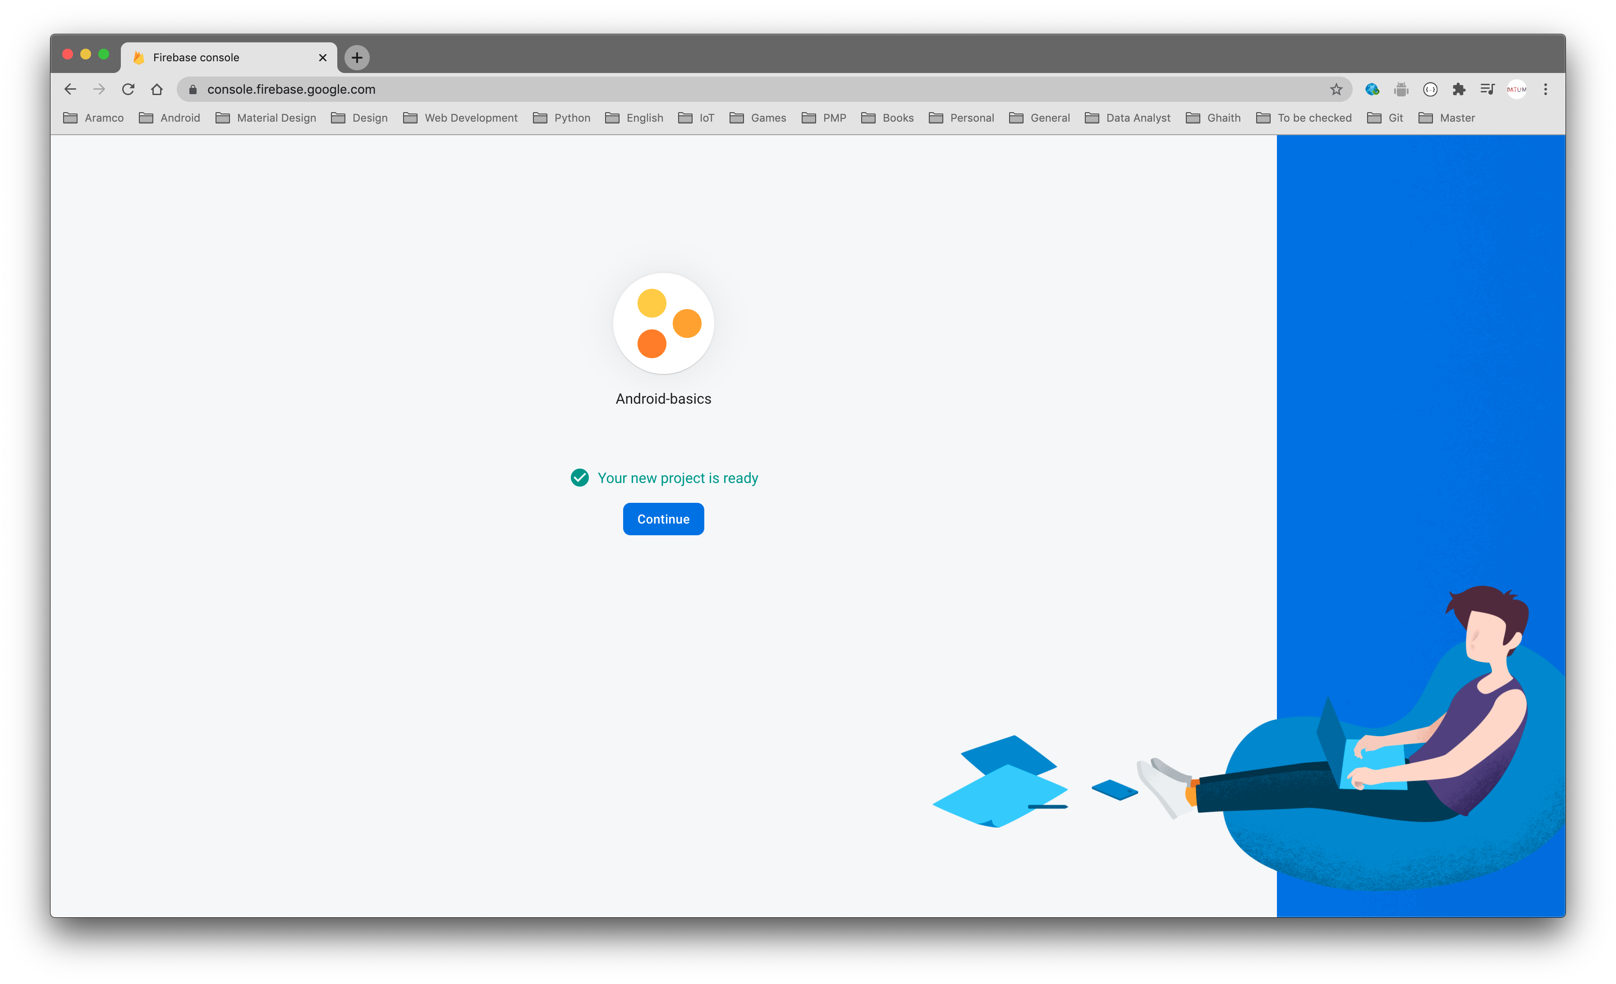

Slide 110
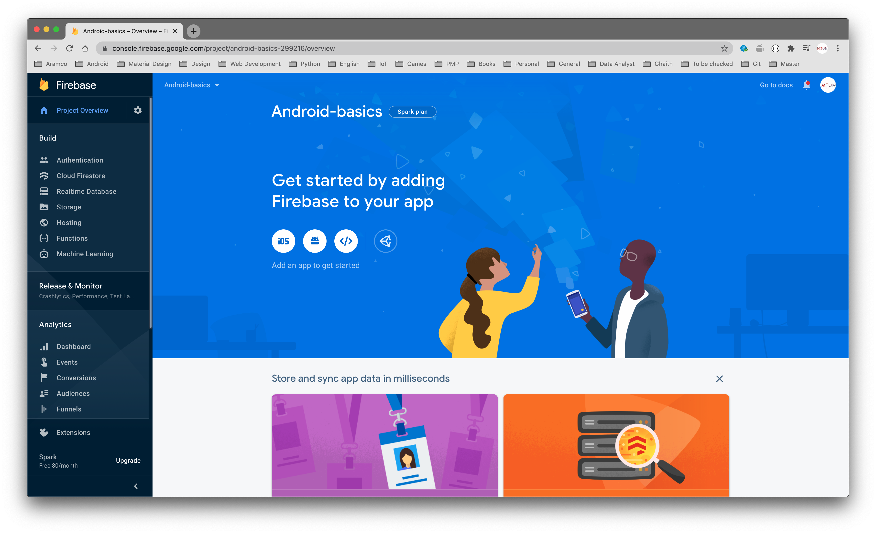

Slide 111
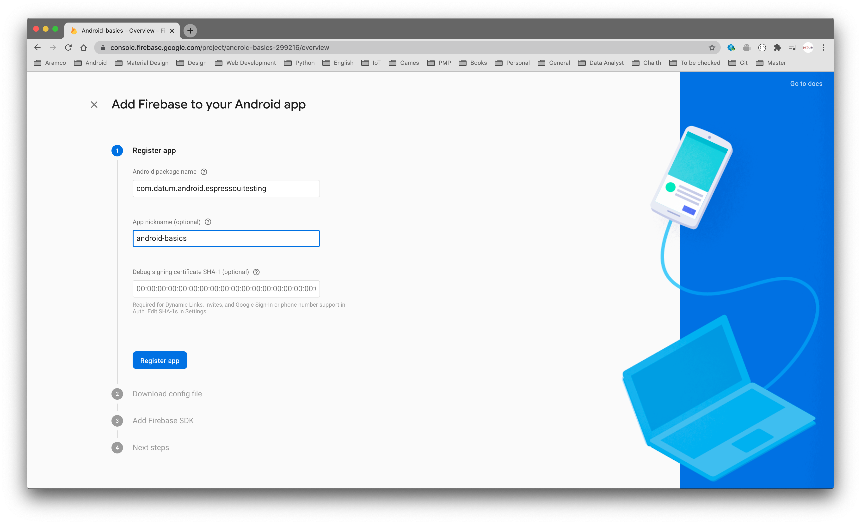

Slide 112
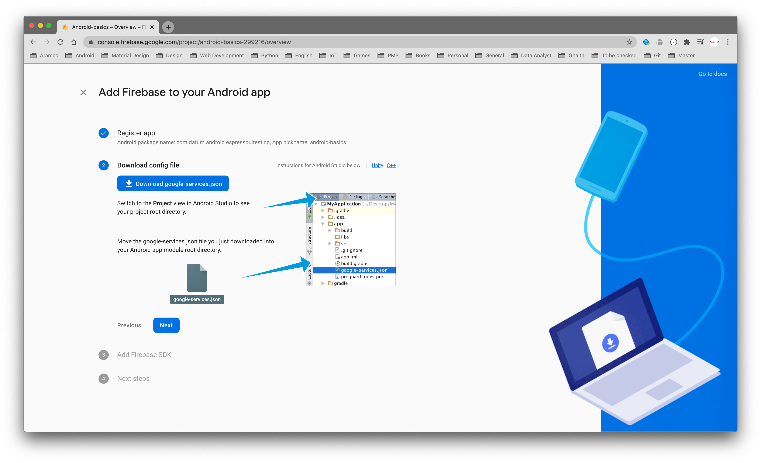

Slide 113
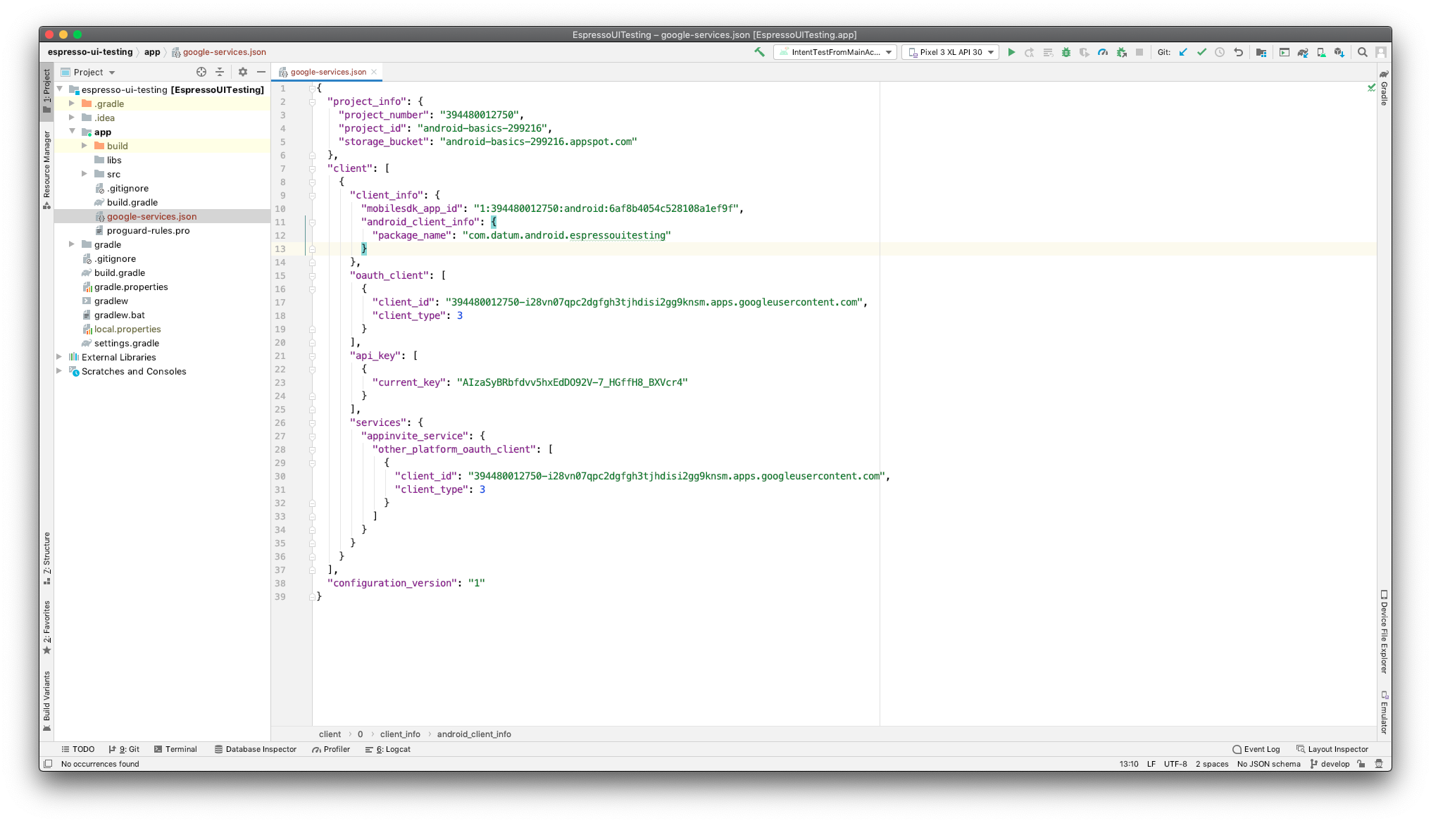

Slide 114
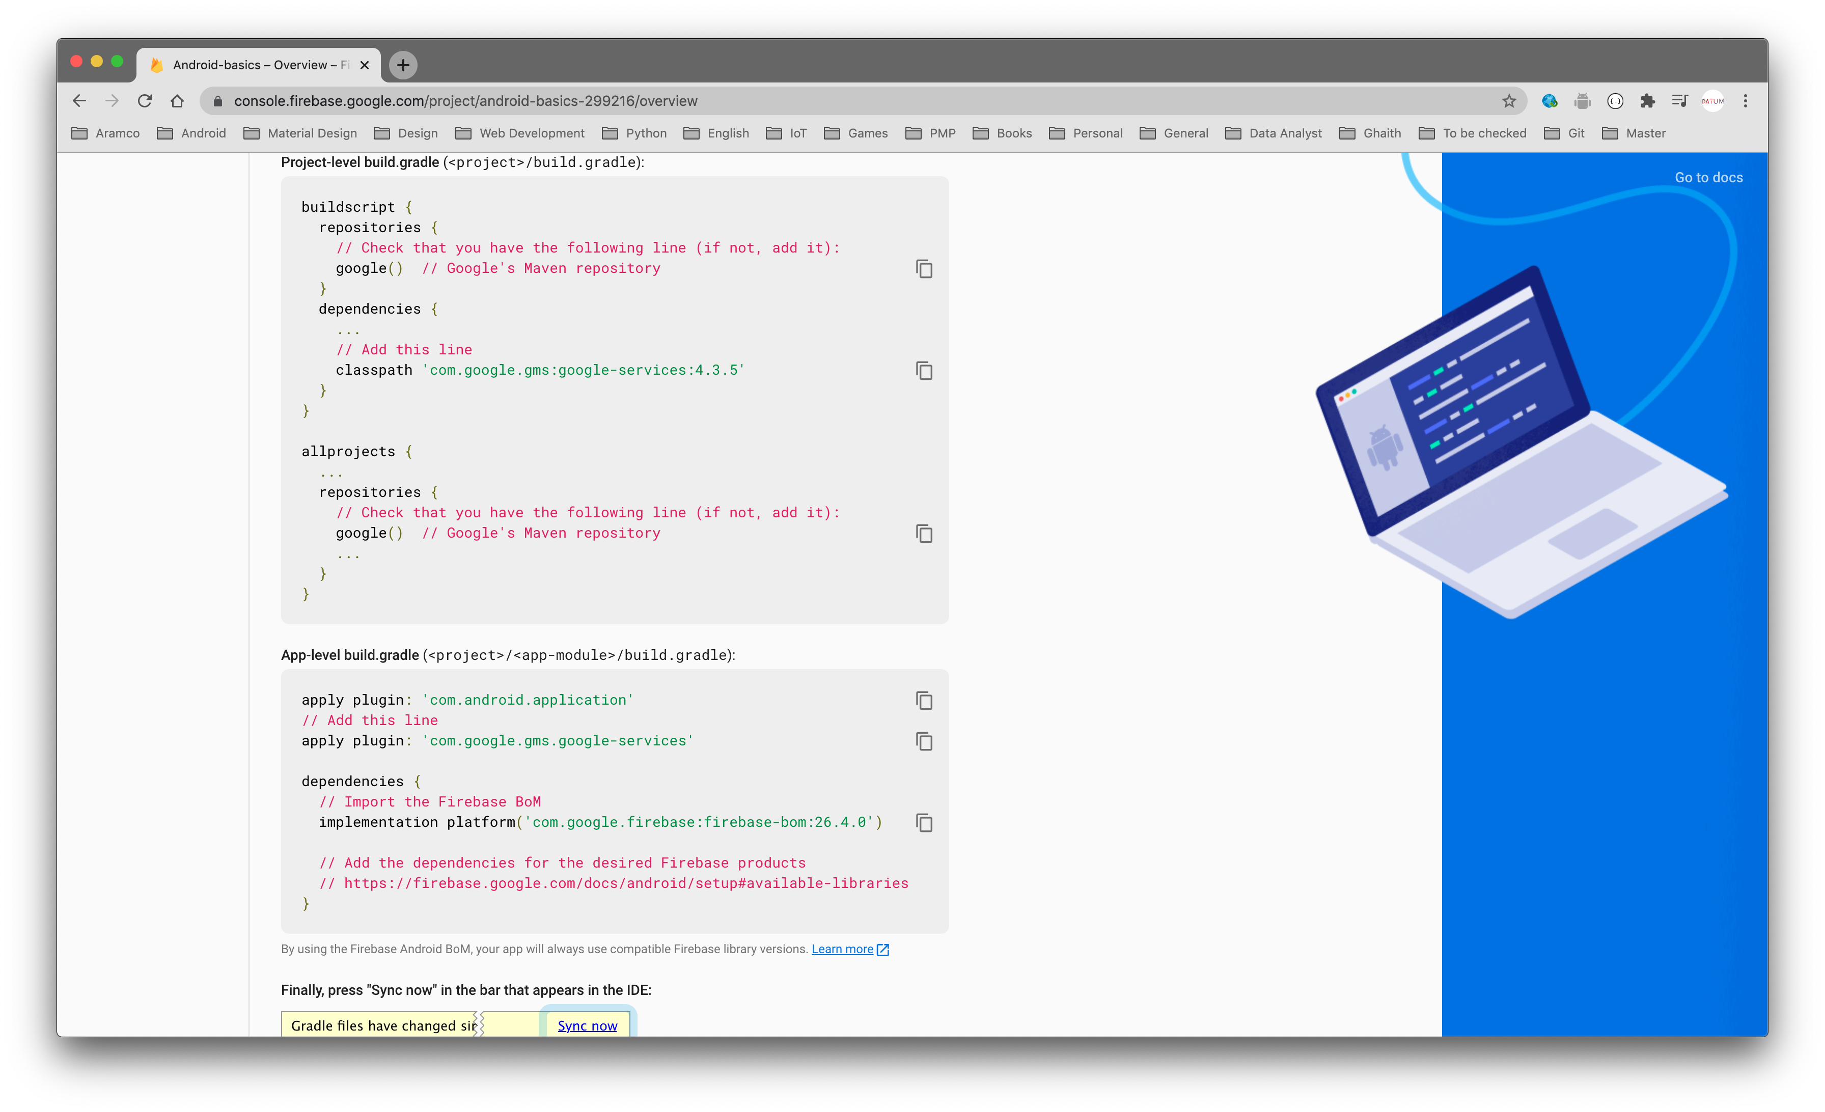

Slide 115
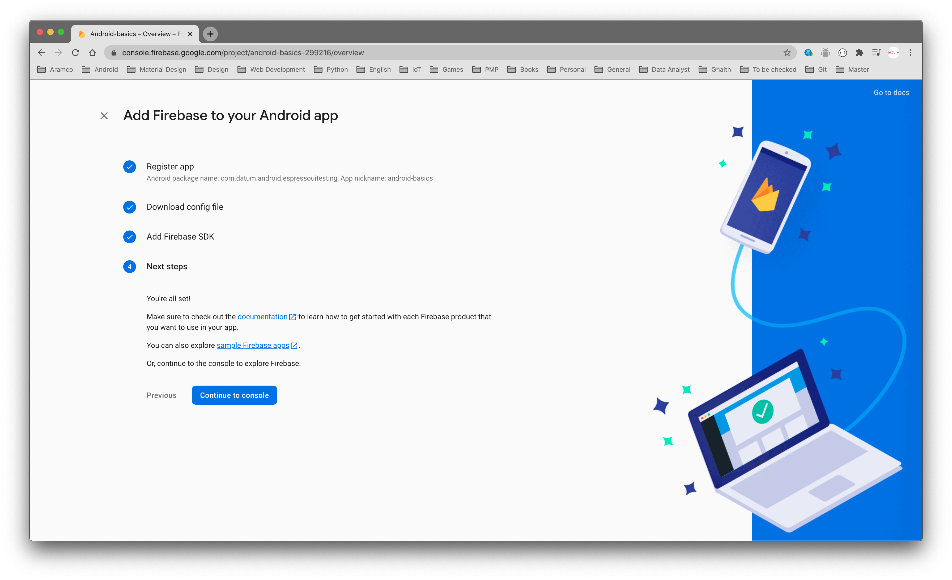

Slide 116
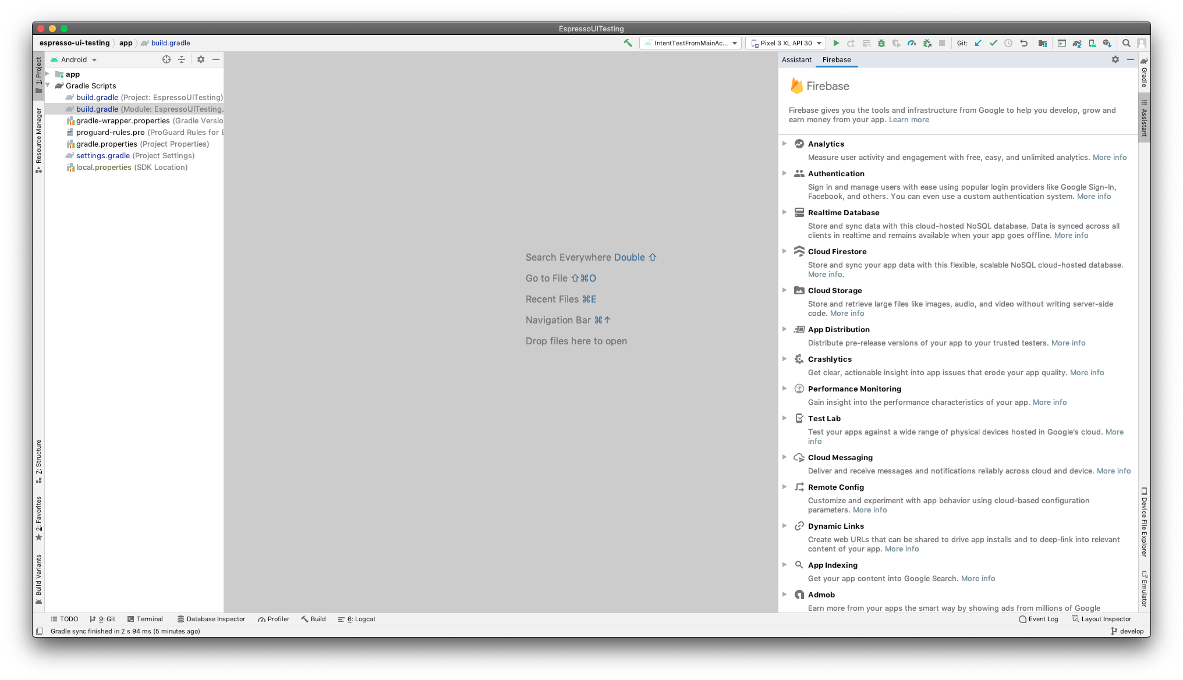

Slide 117
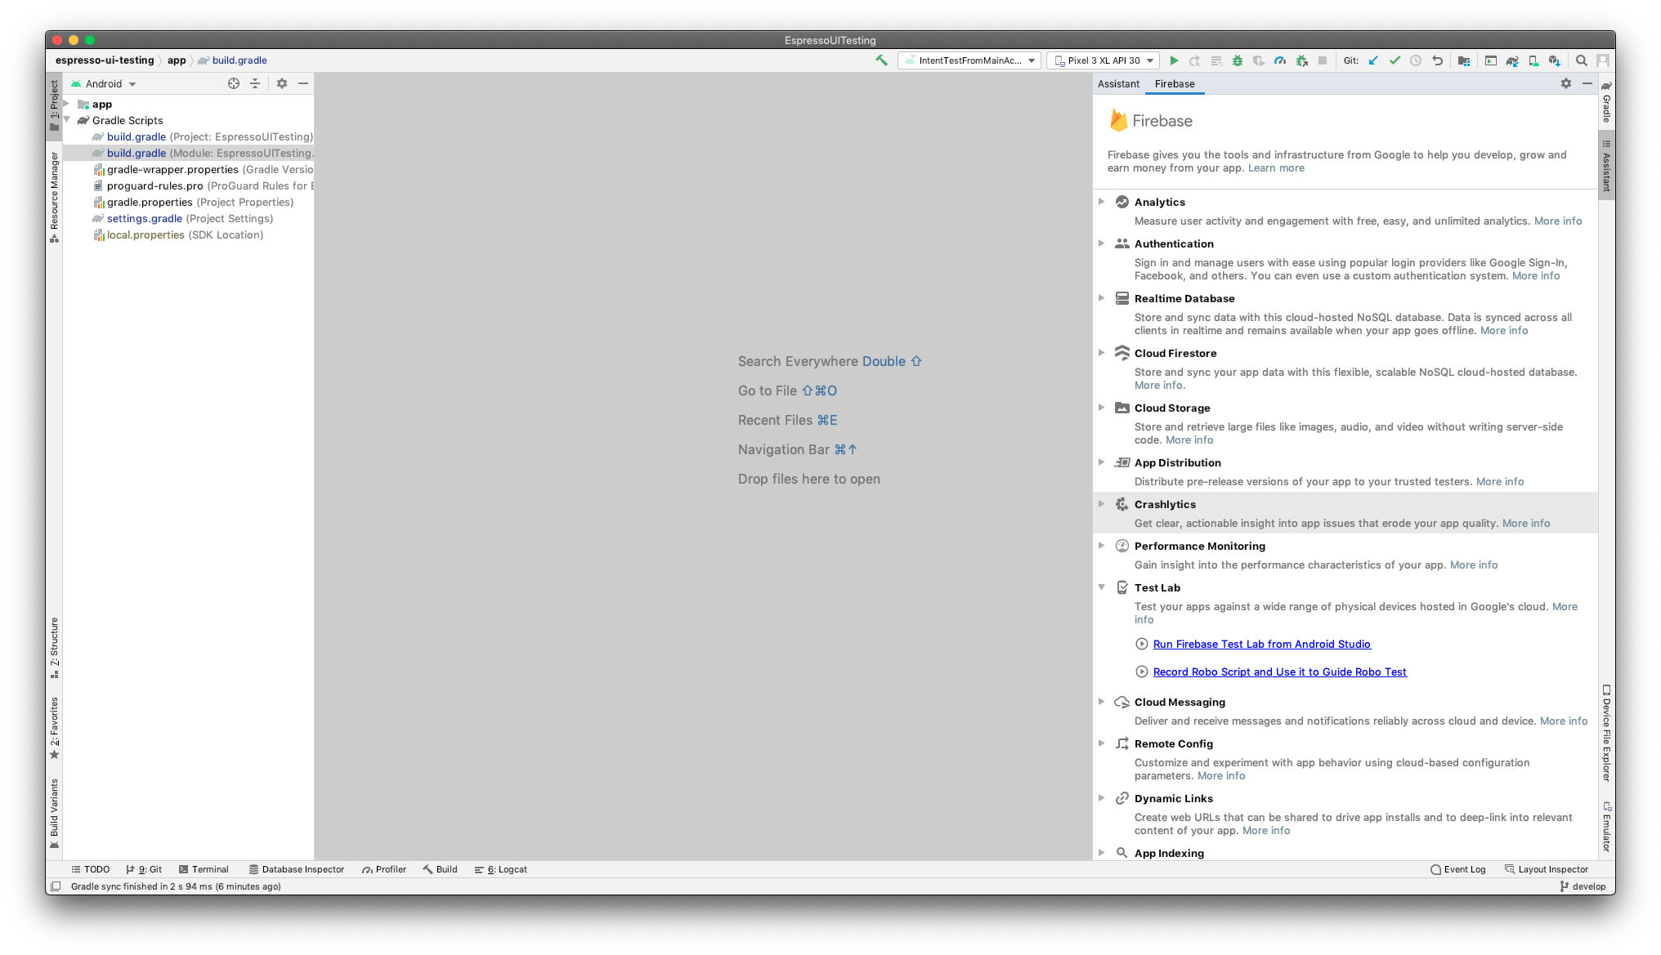

Slide 118
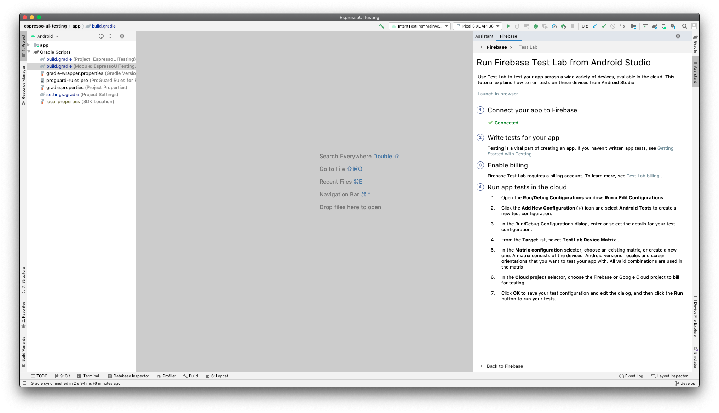

Slide 119
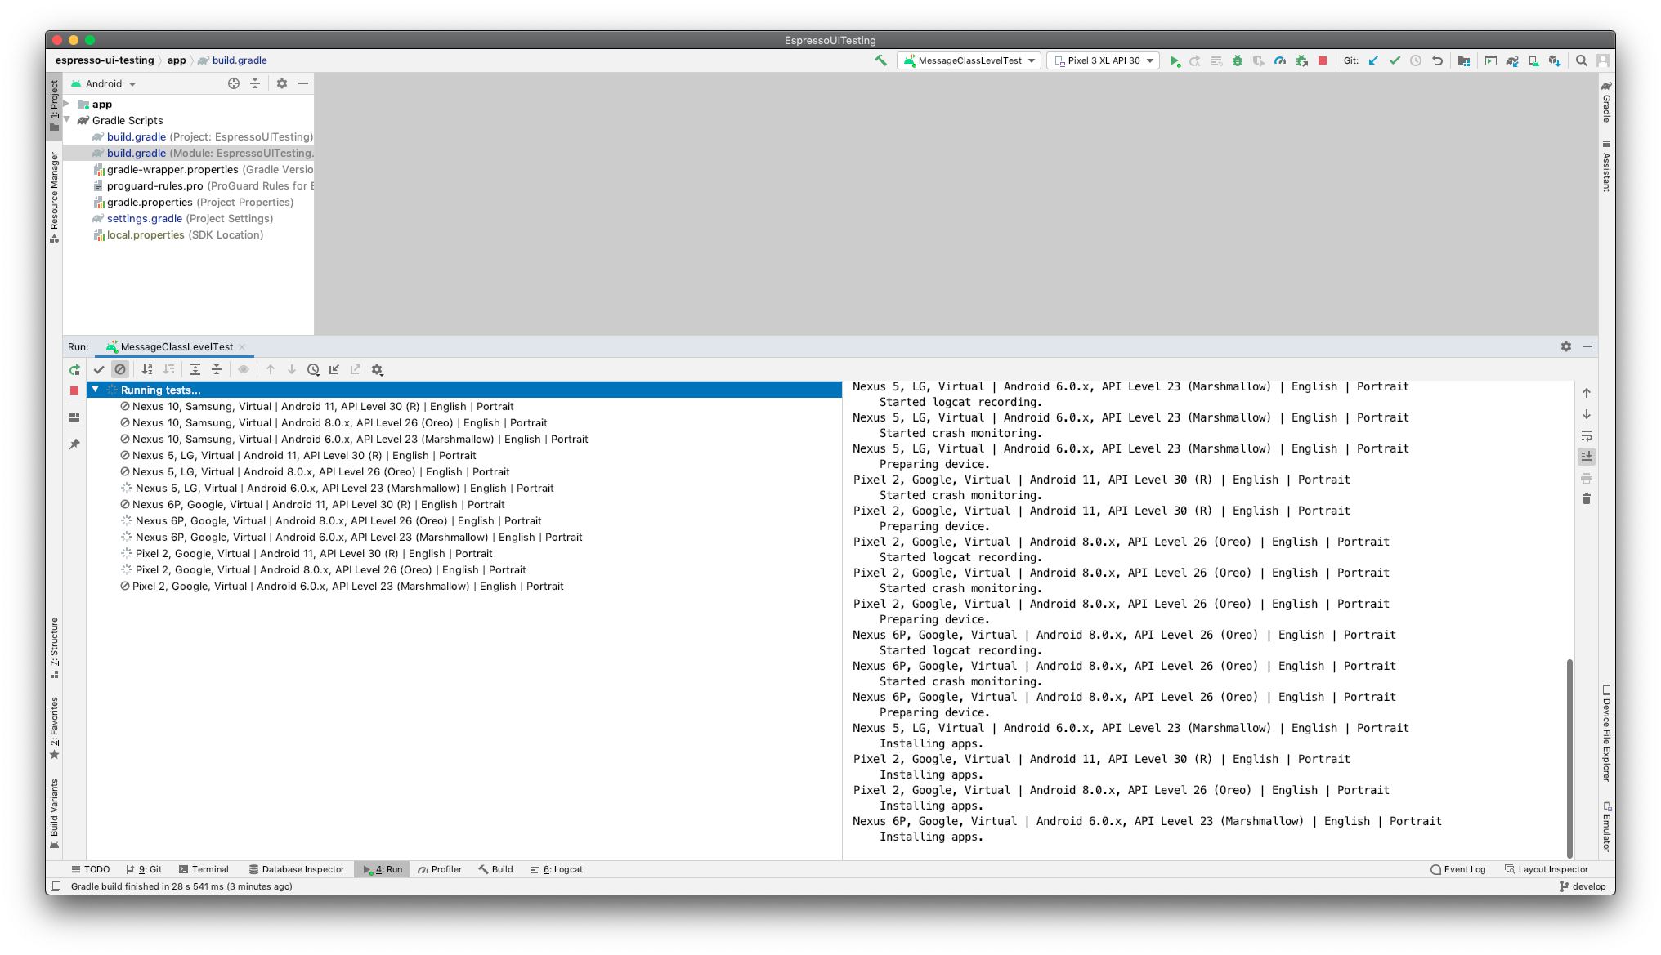

Slide 120
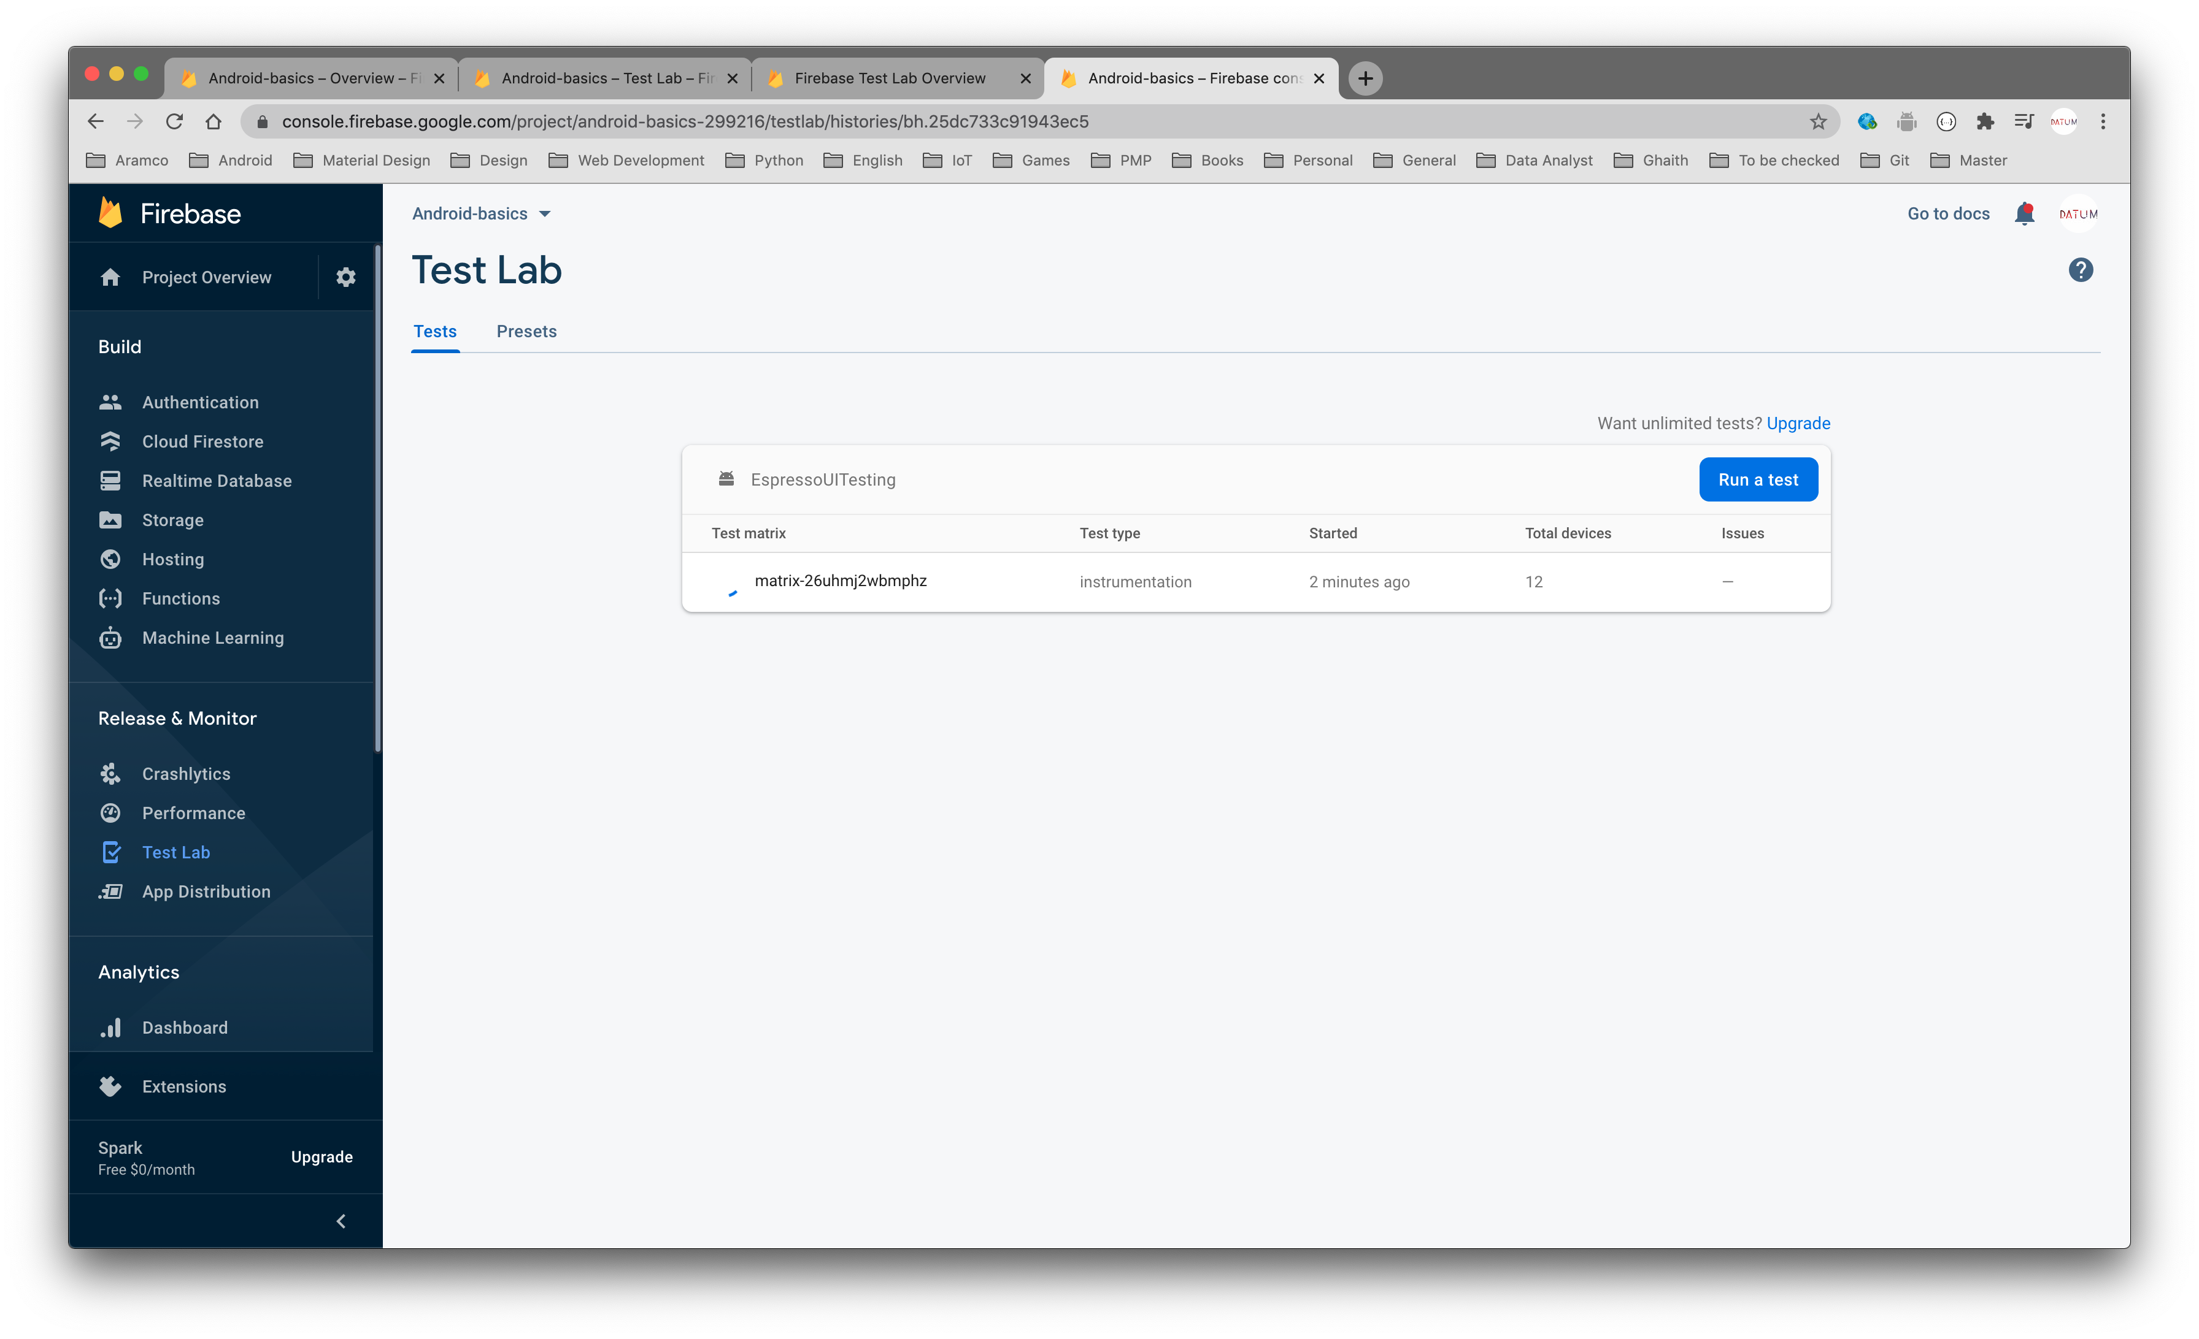

Slide 121
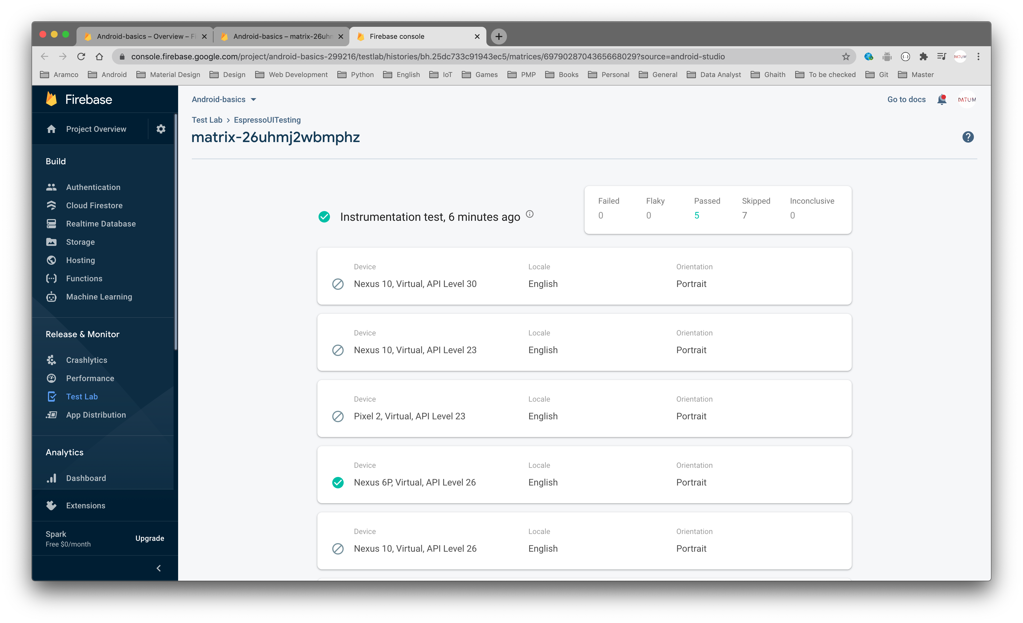

Slide 122
https://github.com/android/testing-samples

Slide 123
Thanks

